Slide 1
Annual Report 2025

Slide 4
Suggested citation
Burnet Institute and Kirby Institute. Australia’s progress towards hepatitis C elimination: annual report 2025. Melbourne: Burnet Institute; 2025.
ISBN: 978-0-646-72967-1
DOI: https://doi.org/10.26190/unsworks/31756

Slide 5
The Burnet and Kirby Institutes
Prepared by:
Anna Wilkinson
Samara Griffin
Edited by:
Margaret Hellard
Mark Stoové
Gregory Dore
Jason Grebely
Alisa Pedrana
Joseph Doyle
Alexander Thompson
Behzad Hajarizadeh
Timothy Broady
Troy Combo

Slide 6
Data Contributors
Australian Collaboration for Coordinated Enhanced Sentinel Surveillance of Sexually Transmissible Infections and Blood Borne Viruses: Margaret Hellard, Mark Stoove, Jason Asselin, Michael Traeger, Victoria Polkinghorne, Nyssa Watson, Thi Nguyen, Carol El‑Hayek, and Samara Griffin (Burnet Institute); Rebecca Guy, Basil Donovan, Allison Carter, Htein Linn Aung, and Stella Lintzeris (Kirby Institute); Wayne Dimech (NRL Quality).
Australian Needle Syringe Program Survey: Sue Heard, Bradley Mathers, and Lisa Maher (Kirby Institute).
National Prisons Hepatitis Network: Yumi Sheehan, Andrew Lloyd, and Behzad Hajarizadeh (Kirby Institute); Alexander Thompson (St Vincent’s Hospital Melbourne); Rebecca Winter and Mark Stoove (Burnet Institute).
New South Wales HIV and Hepatitis C Dried Blood Spot Testing Pilot: Bianca Prain and Rick Varma (New South Wales Health); Philip Cunningham (St Vincent’s Reference Laboratory for HIV).
Monitoring hepatitis C treatment uptake in Australia: Joanne Carson, Behzad Hajarizadeh, and Gregory Dore (Kirby Institute).
National hepatitis C diagnosis and care cascade: Jisoo Amy Kwon, Gregory Dore, Behzad Hajarizadeh, Maryam Alavi, Heather Valerio, Jason Grebely, Rebecca Guy, Richard Gray, Jenny Iversen, Lisa Maher, Jonathan King, and Skye McGregor (Kirby Institute); members of the Australian HCV Diagnosis and Care Cascade Reference Group.
Australia and New Zealand Liver and Intestinal Transplant Registry: Michael Fink and Wing‑Yee Lo (Victorian Liver Transplant Unit, Austin Health); Simone Strasser (Australian National Liver Transplant Unit, Royal Prince Alfred Hospital); Peter Hodgkinson (Queensland Liver Transplant Service, Princess Alexandra Hospital); John Chen (South Australian Liver Transplant Unit, Flinders Medical Centre); Robert Jones (Victorian Liver Transplant Unit, Austin Health); Luc Delriviere (Western Australian Liver Transplantation Service, Sir Charles Gairdner Hospital).
Stigma Indicators Monitoring Project: Timothy Broady, Loren Brener, Elena Cama, and Carla Treloar (Centre for Social Research in Health, University of New South Wales).

Slide 7
Data Contributors (cont.)
Needle Syringe Program National Minimum Data Collection: Sue Heard, Bradley Mathers, and Lisa Maher (Kirby Institute).
GBQ+ Community Periodic Survey: Timothy Broady, James MacGibbon, Anthony Smith, Limin Mao, and Martin Holt (Centre for Social Research in Health, University of New South Wales); Benjamin Bavinton and Curtis Chan (Kirby Institute).
Viral Hepatitis Mapping Project: Jennifer MacLachlan and Benjamin Cowie (WHO Collaborating Centre for Viral Hepatitis, Peter Doherty Institute for Infection and Immunity).
Mathematical modelling: Jisoo Amy Kwon, Gregory Dore, Jason Grebely, Behzad Hajarizadeh, Rebecca Guy, and Richard Gray (Kirby Institute); Chris Estes and Homie Razavi (Centre for Disease Analysis).
Mathematical modelling: Farah Houdroge, Kelvin Burke, and Nick Scott (Burnet Institute).

Slide 8
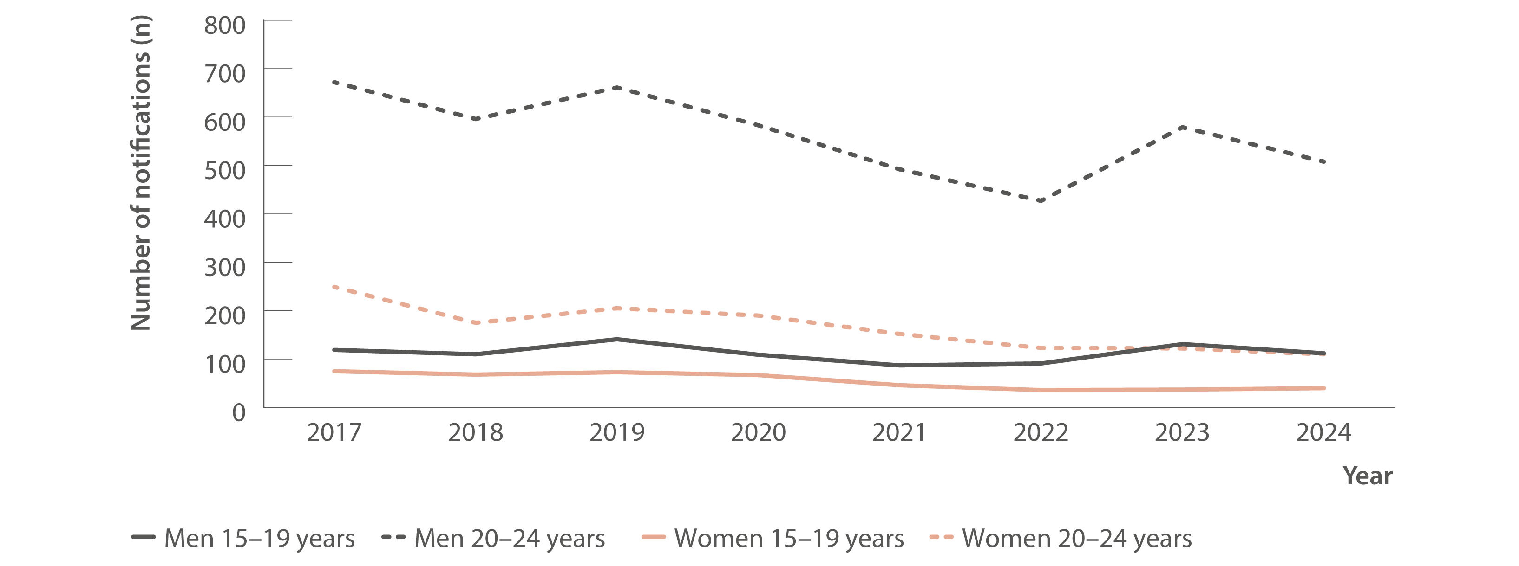
Figure 1. Number of hepatitis C notifications by age group and gender, 2017–2024
New infections
Source: Australian National Notifiable Diseases Surveillance System.(4,11)
Notes:
Notes: Cases other than newly acquired were assigned as unspecified.

Slide 9
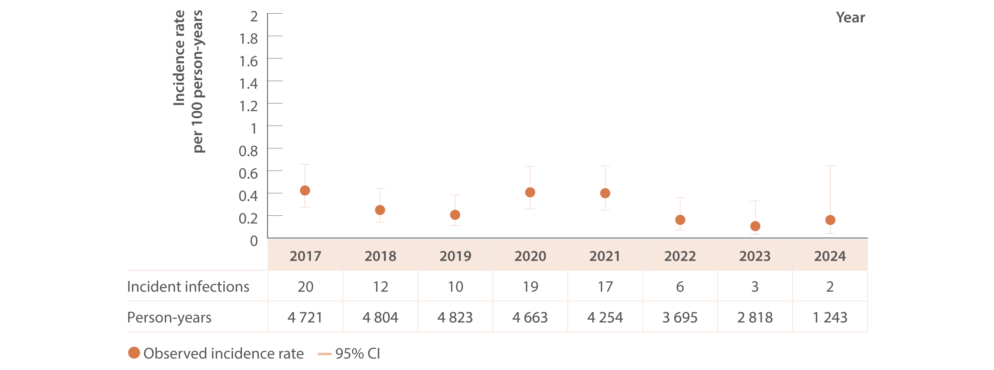
Figure 2. Incidence of primary hepatitis C infection among individuals tested at ACCESS primary care clinics, ACCESS, 2017–2024
New infections
Source: ACCESS.(13)
Notes:
Notes: Analysis includes N=14 998 individuals and 24 818 tests (2009–2024) with data from 2017 shown for brevity. Analysis includes 18 sites: 16 in Victoria (VIC), one in Western Australia (WA), and one in Queensland (QLD). Primary care clinics see high caseloads of people at risk of hepatitis C and provide both specialist services to current or former people who
inject drugs as well as general health services. First incident infection only included in analysis. Incident infection date was assigned as the midpoint between the positive HCV antibody or HCV RNA test date and previous HCV antibody negative test date. ACCESS collates data from January 2009. Individuals included tested HCV antibody negative on their first test observed and had at least one follow‑up test (HCV antibody or HCV RNA or both) on or before 31 December 2024. Individuals were 15 years or older. CI: confidence interval.

Slide 10
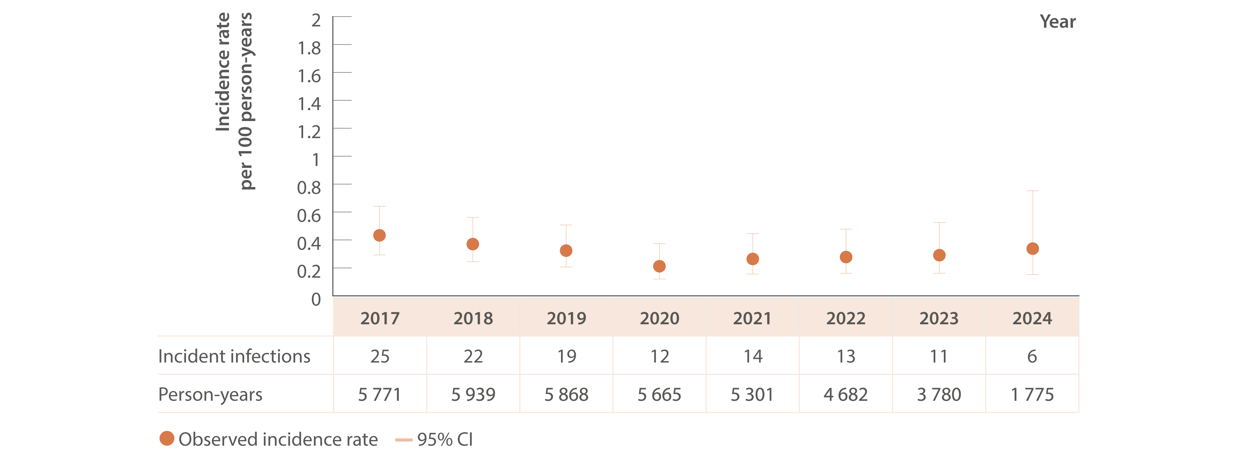
Figure 3. Incidence of primary hepatitis C infection among GBM living with HIV tested at ACCESS GBM or sexual health clinics, ACCESS, 2017–2024
New infections
Source: ACCESS.(13)
Notes:
Notes: Analysis includes N=9 507 individuals and 69 679 tests (2009–2024) with data from 2017 shown for brevity. Analysis includes 23 sites: 12 in New South Wales (NSW), four in VIC, two in South Australia (SA), two in WA, two in QLD, and one in Tasmania (TAS). GBM were classed as being HIV‑positive for the entire calendar year of their diagnosis and were 15 years or older. First incident infection only included in analysis. Incident infection date was assigned as the midpoint between the positive HCV antibody or HCV RNA test date and previous HCV antibody negative test date. ACCESS collates data from January 2009. Individuals included tested HCV antibody negative on their first test observed and had at least one follow‑up test (HCV antibody or HCV RNA or both) on or before 31 December 2024. CI: confidence interval.

Slide 11
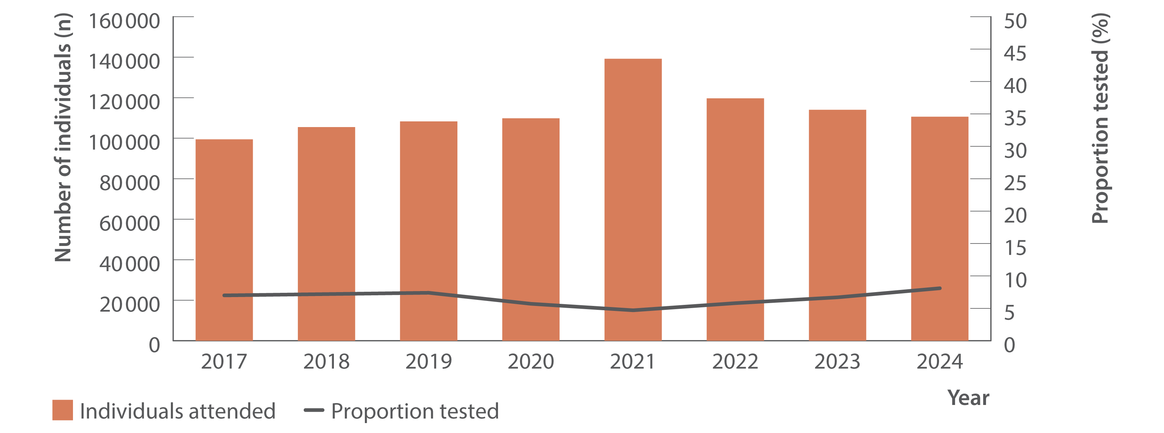
Figure 4. Number of individuals attending ACCESS primary care clinics and proportion tested for HCV (HCV antibody only or HCV antibody and RNA or HCV RNA only), ACCESS, 2017–2024
Testing and diagnosis
Source: ACCESS.(13)
Notes:
Notes: Analysis includes 18 sites: 16 in VIC, one in WA, and one in QLD. Primary care clinics see high caseloads of people at risk of hepatitis C and provide both specialist services to current and former people who inject drugs as well as general health services. Clinic attendances included in‑person and telehealth consultations. Individuals were 15 years or older and contributed one consultation and one test per year.

Slide 12
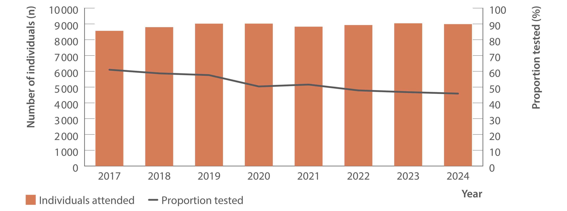
Figure 5. Number of GBM living with HIV attending ACCESS GBM or sexual health clinics and proportion tested for HCV (HCV antibody only or HCV antibody and RNA or HCV RNA only), ACCESS, 2017–2024
Testing and diagnosis
Source: ACCESS.(13)
Notes:
Notes: Analysis includes 23 sites: 12 in NSW, four in VIC, two in SA, two in WA, two in QLD, and one in TAS. Clinic attendances included in‑person and telehealth consultations. GBM were classed as being HIV‑positive for the entire calendar year of their diagnosis, were 15 years or older, and contributed one consultation and one test per year.

Slide 13
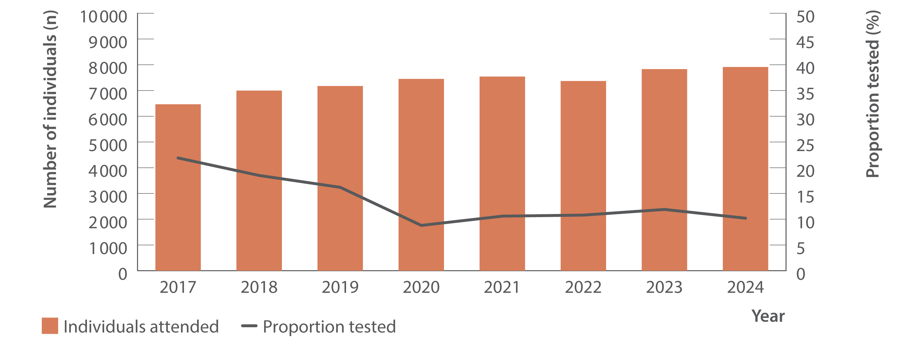
Figure 6. Number of individuals ever prescribed opioid agonist therapy attending ACCESS primary care clinics and proportion tested for HCV (HCV antibody only or HCV antibody and RNA or HCV RNA only), ACCESS, 2017–2024
Testing and diagnosis
Source: ACCESS.(13)
Notes:
Notes: Analysis includes 18 sites: 16 in VIC, one in WA, and one in QLD. Primary care clinics have high caseloads of people at risk of hepatitis C and provide both specialist services to current and former people who inject drugs as well as general health services. Clinic attendances included in‑person and telehealth consultations. Individuals were 15 years or older, had at least one electronic medical record of a prescription for opioid agonist therapy between January 2009 and December 2024, and contributed one consultation and one test per year.

Slide 14
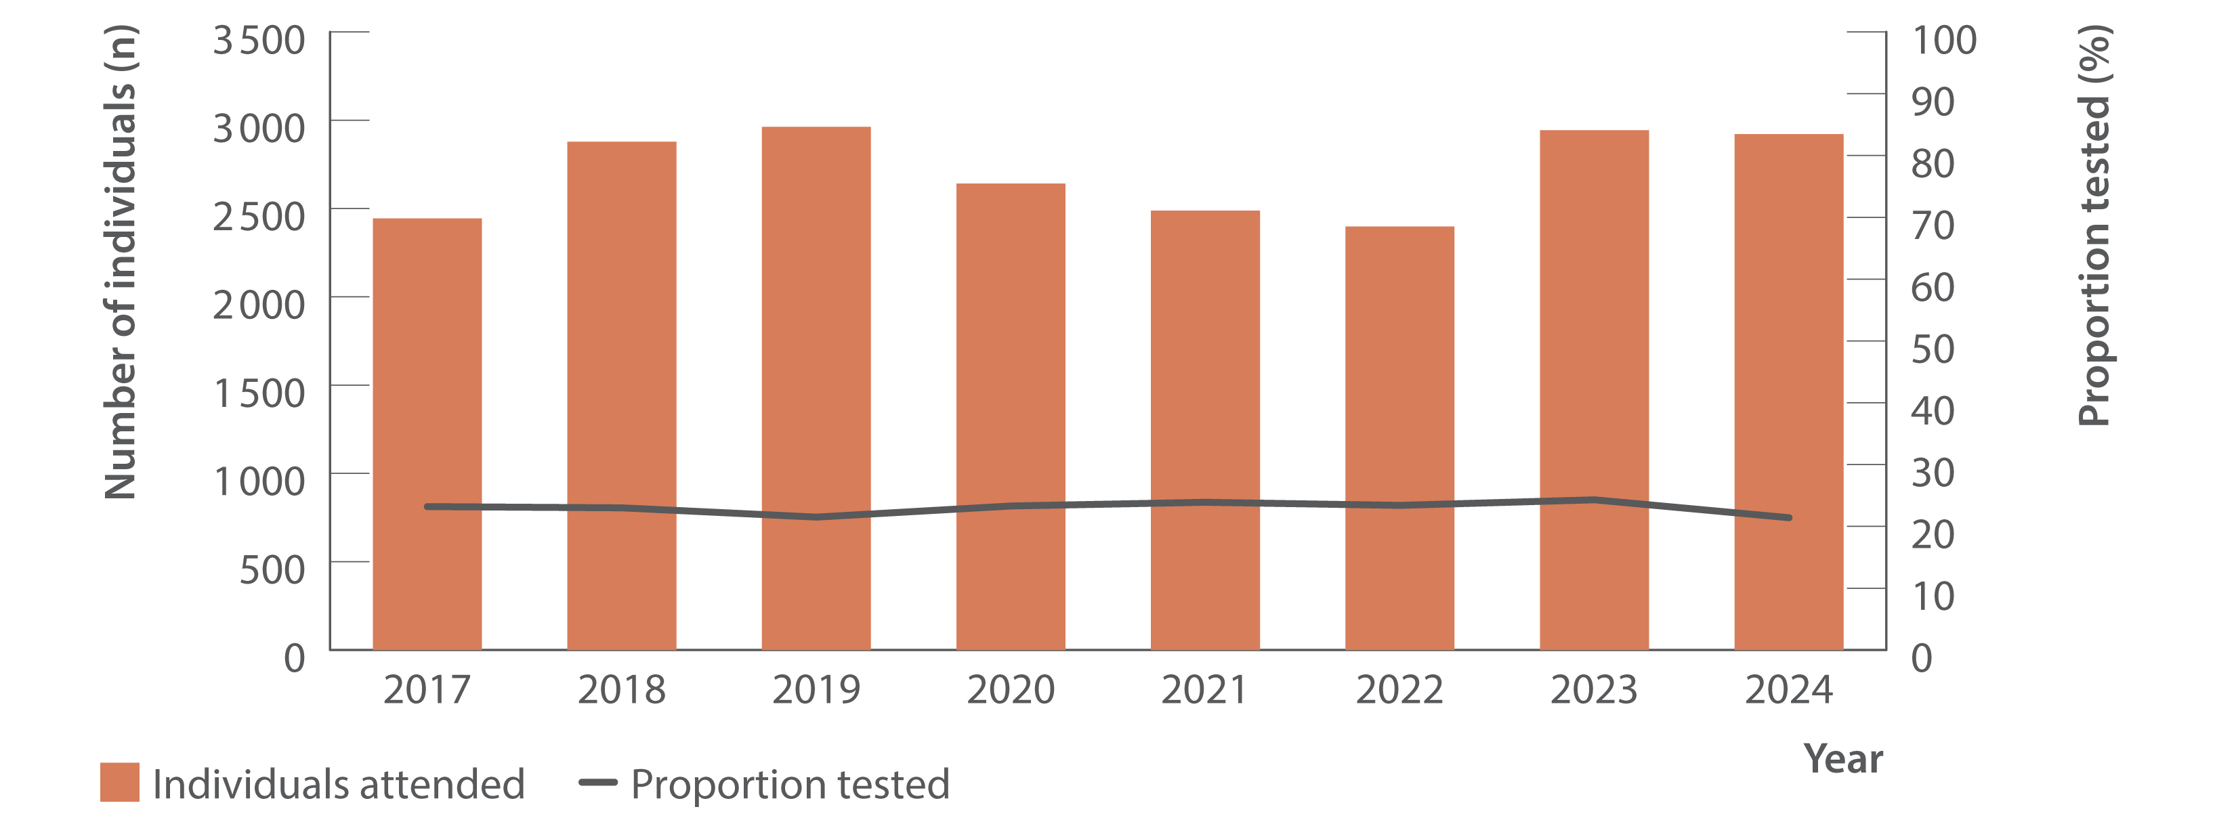
Figure 7. Number of Aboriginal and/or Torres Strait Islander people attending ACCESS sexual health or primary care clinics and proportion tested for HCV (HCV antibody only or HCV antibody and RNA or HCV RNA only), ACCESS, 2017–2024
Testing and diagnosis
Source: ACCESS.(13)
Notes:
Notes: Analysis includes 19 sites: seven in NSW, six in VIC, three in QLD, two in WA and one in SA. Clinic attendances included in‑person and telehealth consultations. Individuals were 15 years or older and contributed one consultation and one test per year. Overall, of unique individuals who attended included clinics 2014–2024 for a consultation (N=538 044), 3% of people had no Aboriginal or Torres Strait Islander status recorded (missing), 7% were recorded as ‘not stated’, 87% were neither Aboriginal nor Torres Strait Islander people, and 3% were Aboriginal and Torres Strait Islander people. Two clinics
included in this analysis are primary care clinics specialising in the health of GBM, so some individuals presented in this data may also be presented in ACCESS data relating to GBM.

Slide 15
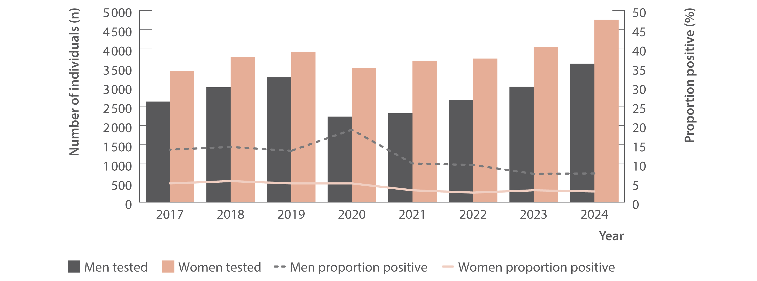
Figure 8. Number of individuals tested for HCV antibody at ACCESS primary care clinics and proportion of HCV antibody tests positive by gender, ACCESS, 2017–2024
Testing and diagnosis
Source: ACCESS.(13)
Notes:
Notes: Analysis includes 18 sites: 16 in VIC, one in WA, and one in QLD. Primary care clinics have high caseloads of people at risk of hepatitis C and provide both specialist services to current and former people who inject drugs as well as general health services. Individuals were 15 years or older and contributed one test per year. Individuals recorded as a gender other than man or woman were not reported due to small sample size. Individuals included either had no previous HCV antibody test recorded in ACCESS since 2009 or had previously tested HCV antibody negative. Individual’s HCV antibody tests after an HCV antibody positive test being observed were excluded from analysis.

Slide 16
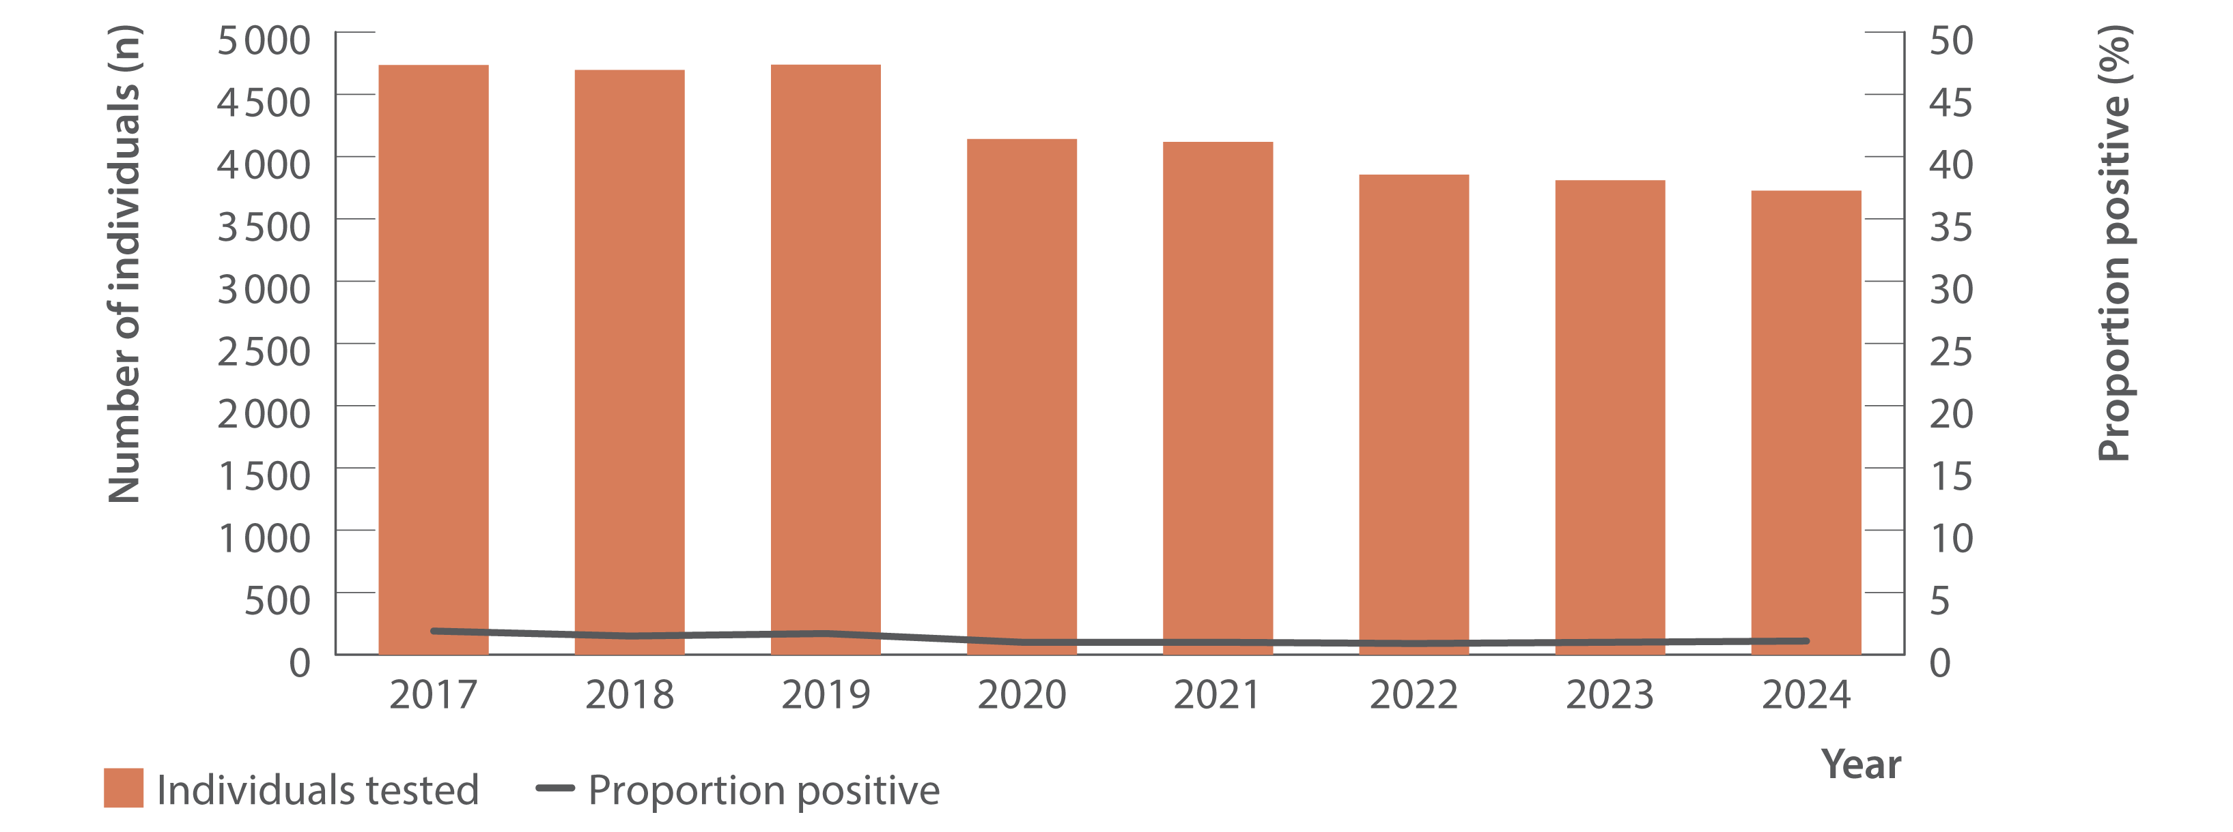
Figure 9. Number of GBM living with HIV tested for HCV antibody at ACCESS GBM or sexual health clinics and proportion of HCV antibody tests positive, ACCESS, 2017–2024
Testing and diagnosis
Source: ACCESS.(13)
Notes:
Notes: Analysis includes 23 sites: 12 in NSW, four in VIC, two in SA, two in WA, two in QLD, and one in TAS. GBM were classed as being HIV‑positive for the entire calendar year of their diagnosis, were 15 years or older, and contributed one test per year. Individuals included either had no previous HCV antibody test recorded in ACCESS since 2009 or had previously tested HCV antibody negative. Individual’s HCV antibody tests after an HCV antibody positive test being observed were excluded from analysis.

Slide 17
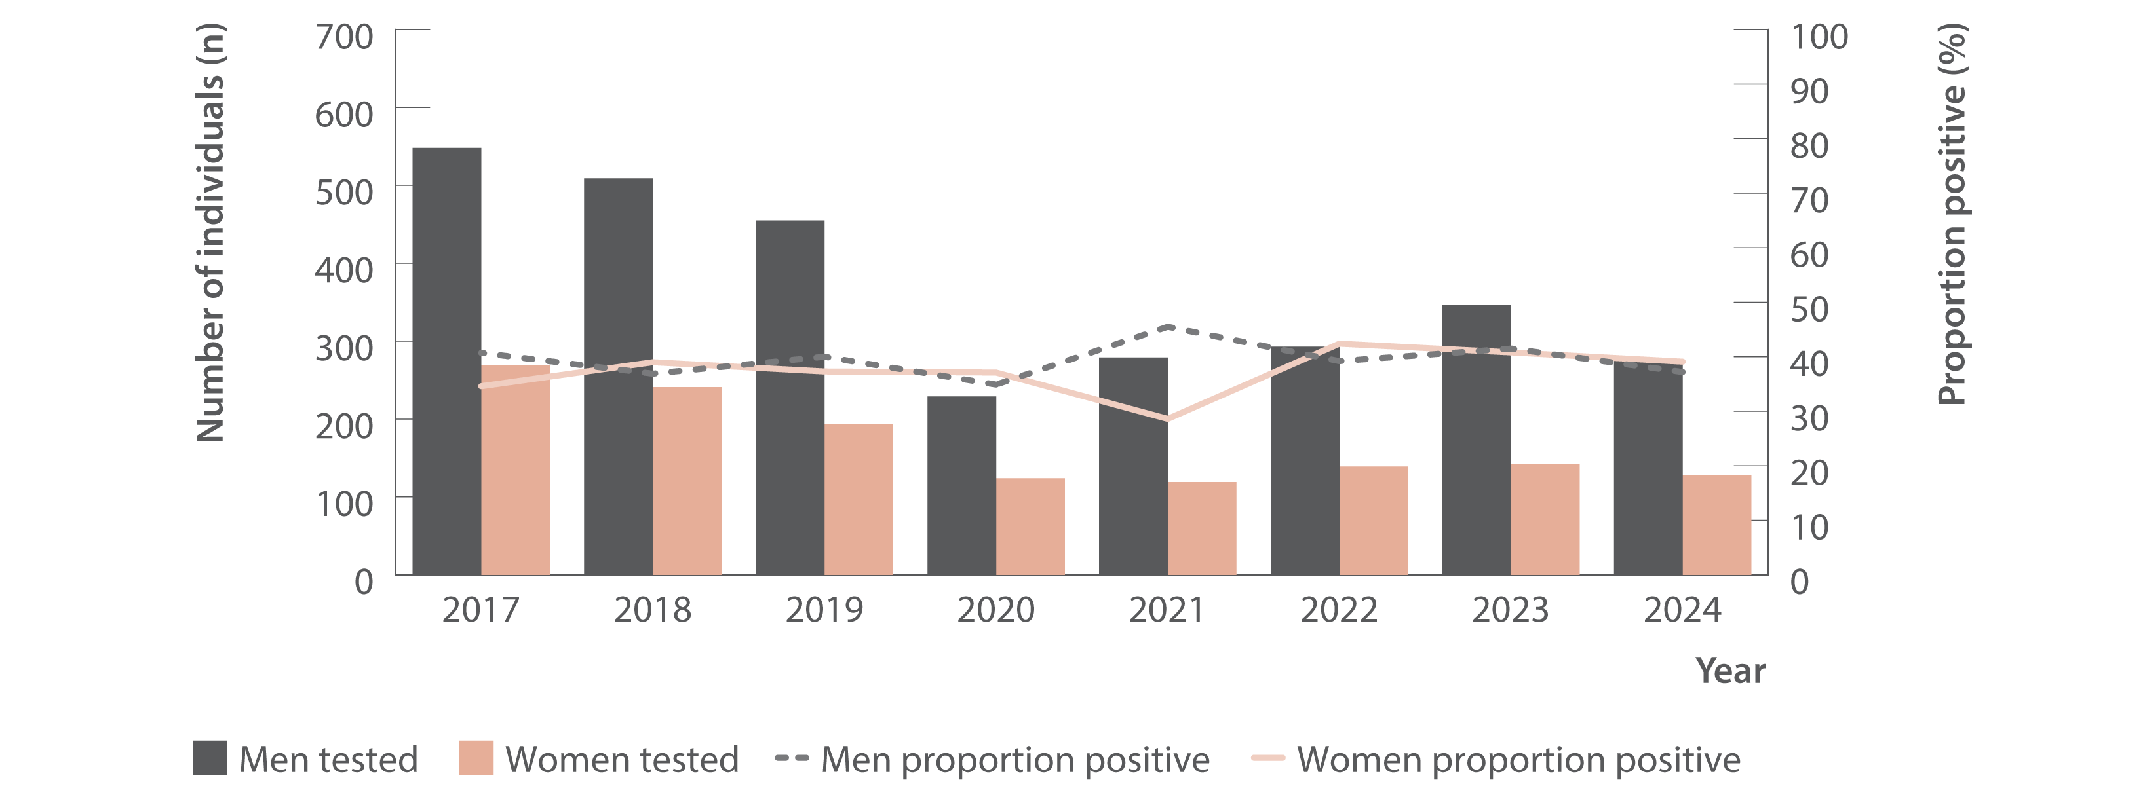
Figure 10. Number of individuals ever prescribed opioid agonist therapy tested for HCV antibody at ACCESS primary care clinics and proportion of HCV antibody tests positive by gender, ACCESS, 2017–2024
Testing and diagnosis
Source: ACCESS.(13)
Notes:
Notes: Analysis includes 18 sites: 16 in VIC, one in WA, and one in QLD. Primary care clinics have high caseloads of people at risk of hepatitis C and provide both specialist services to current and former people who inject drugs as well as general health services. Individuals were 15 years or older, had at least one electronic medical record of a prescription for opioid agonist therapy between January 2009 and December 2024, and contributed one test per year. Individuals recorded as a gender other than man or woman were not reported due to small sample size. Individuals included either had no previous HCV antibody test recorded in ACCESS since 2009 or had previously tested HCV antibody negative. Individual’s HCV antibody tests after an HCV antibody positive test being observed were excluded from analysis.

Slide 18
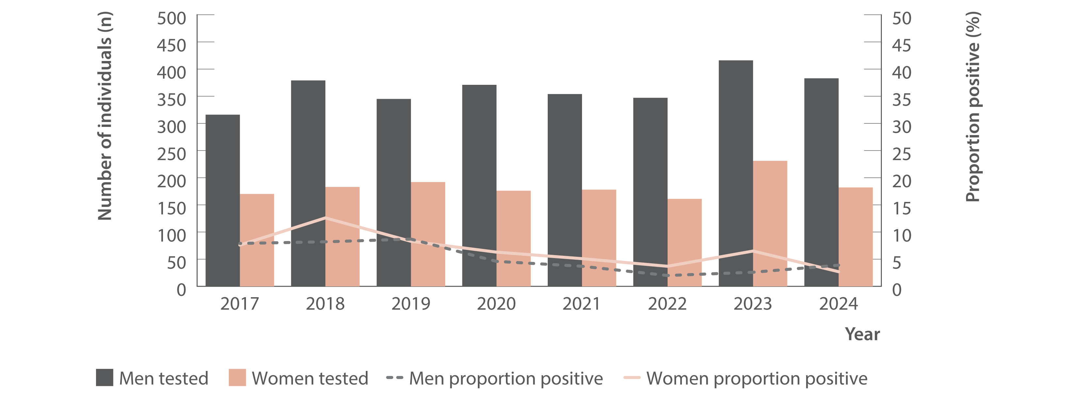
Figure 11. Number of Aboriginal and/or Torres Strait Islander people tested for HCV antibody at ACCESS sexual health or primary care clinics and proportion of HCV antibody tests positive, ACCESS, 2017–2024
Testing and diagnosis
Source: ACCESS.(13)
Notes:
Notes: Analysis includes 19 sites: seven in NSW, six in VIC, three in QLD, two in WA and one in SA. Individuals were 15 years or older and contributed one test per year. Individuals recorded as a gender other than man or woman were not reported due to small sample size. Individuals included either had no previous HCV antibody test recorded in ACCESS since 2009 or had previously tested HCV antibody negative. Individual’s HCV antibody tests after an HCV antibody positive test being observed were excluded from analysis. Two clinics included in this analysis are primary care clinics specialising in GBM, so some individuals presented in this data may also be presented in ACCESS data relating to GBM.

Slide 19
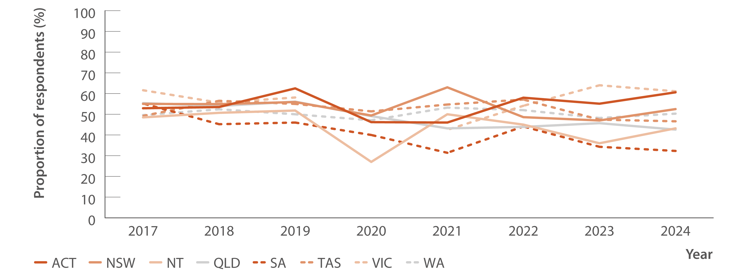
Figure 12. Proportion of Australian Needle Syringe Program Survey respondents self‑reporting recent (past 12 months) hepatitis C testing by jurisdiction, 2017–2024
Testing and diagnosis
Source: Australian NSP survey: Prevalence of HIV, HCV and injecting and sexual behaviour among NSP attendees, 30‑year National Data Report 1995–2024.(18)
Notes:
Notes: No participant recruitment occurred in VIC in 2020.

Slide 20
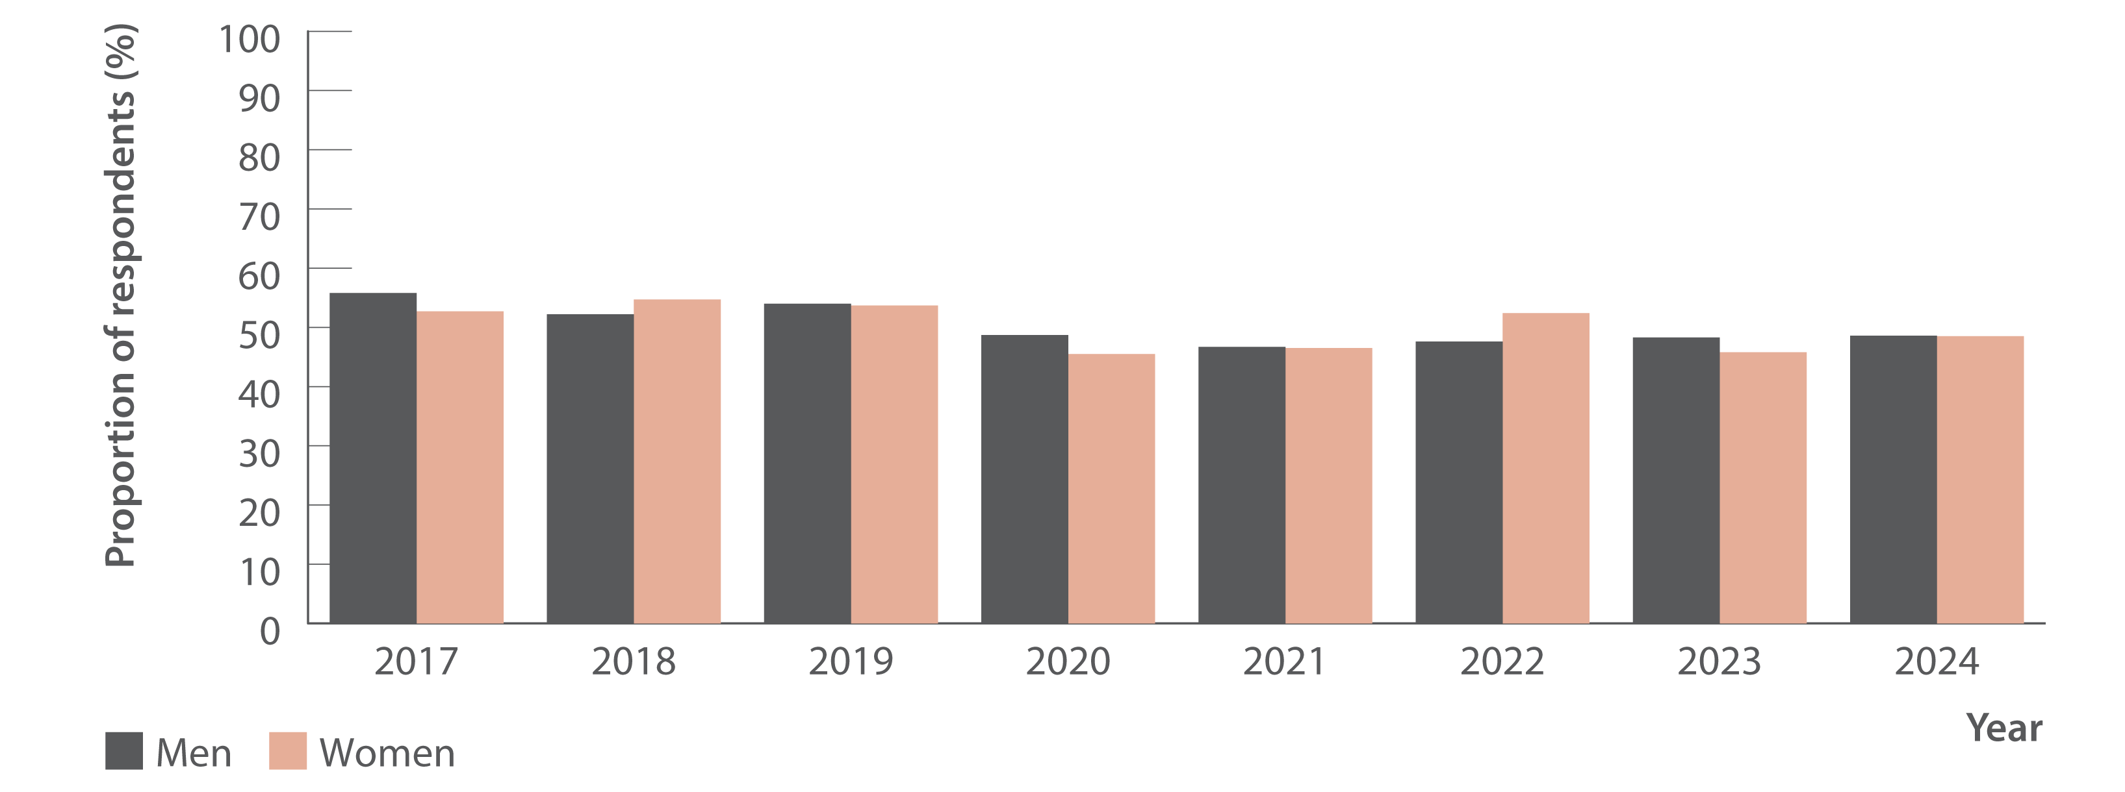
Figure 13. Proportion of Australian Needle Syringe Program Survey respondents reporting recent (past 12 months) hepatitis C testing by gender, 2017–2024
Testing and diagnosis
Source: Australian NSP survey: Prevalence of HIV, HCV and injecting and sexual behaviour among NSP attendees, 30‑year National Data Report 1995–2024.(18)
Notes:
Notes: No participant recruitment occurred in VIC in 2020.

Slide 21
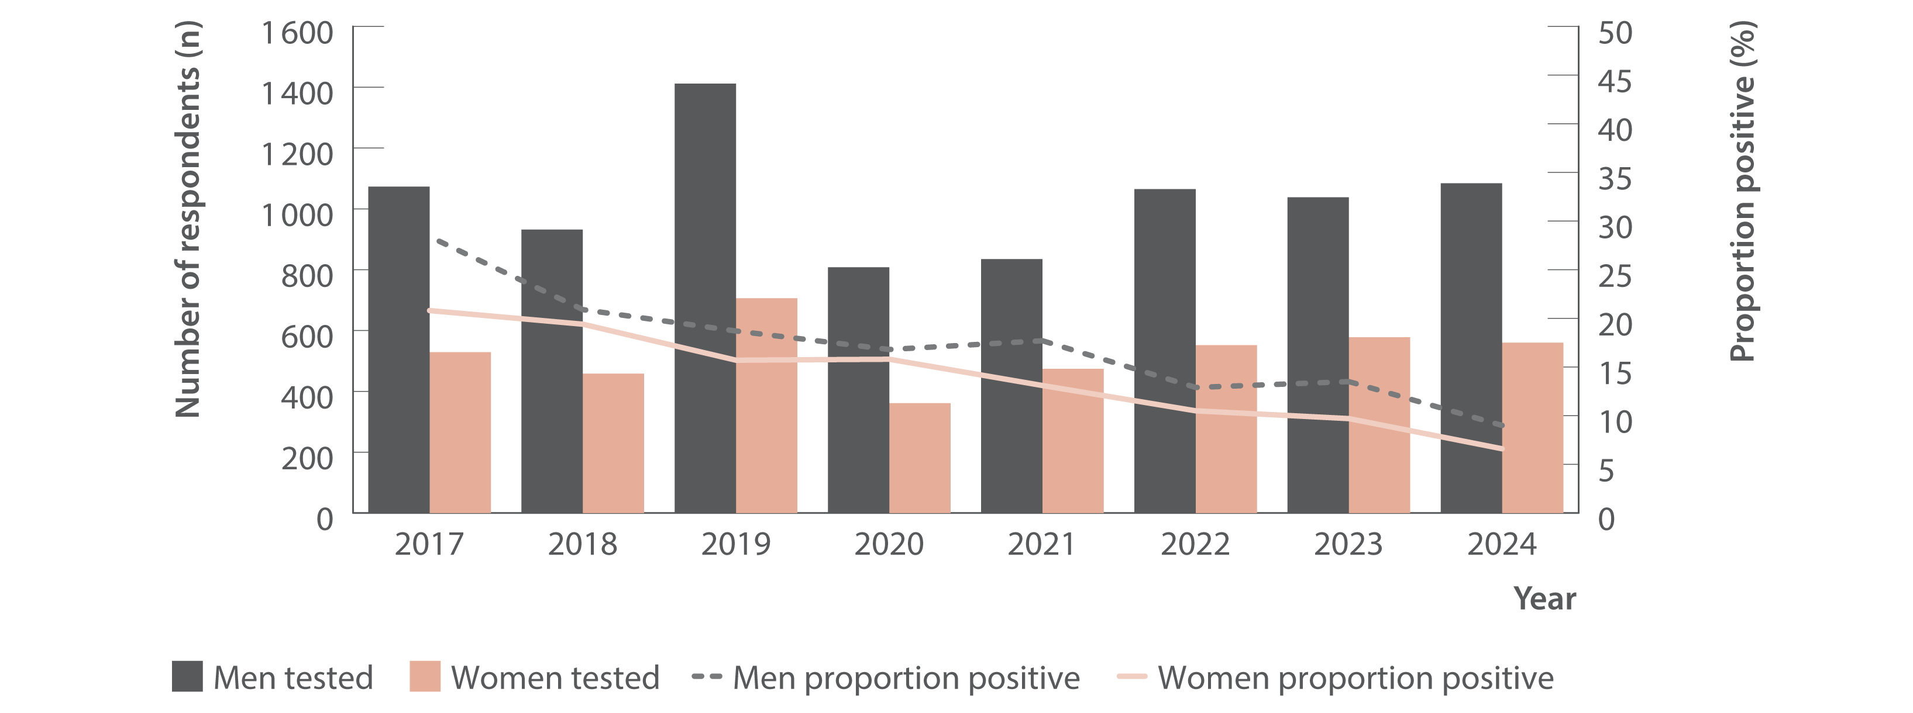
Figure 14. Number of Australian Needle Syringe Program Survey respondents tested for HCV RNA and proportion positive by gender, 2017–2024
Testing and diagnosis
Source: Australian NSP survey: Prevalence of HIV, HCV and injecting and sexual behaviour among NSP attendees, 30‑year National Data Report 1995–2024.(18)
Notes:
Notes: No participant recruitment occurred in VIC in 2020. Weighted for gender and HCV antibody status 2015–2019.

Slide 22
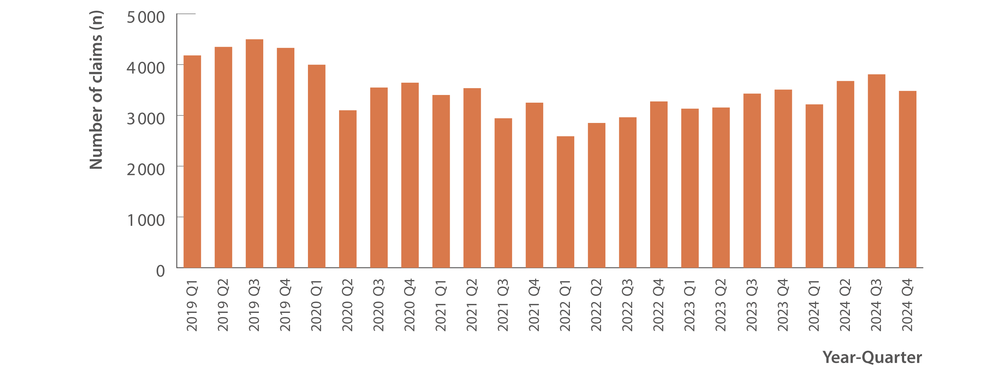
Figure 15. Number of claims to Medicare for items 69499 and 69500 (detection of HCV RNA, new infections only), 2019–2024
Testing and diagnosis
Source: Medicare Australia Statistics.(19)
Notes:
Notes: Medicare Benefit Schedule item numbers (69499 and 69500) are used for testing to detect current hepatitis C infection which are not used for tests associated with treatment monitoring. Prison‑based testing not included in Medicare Benefit Schedule data.

Slide 23
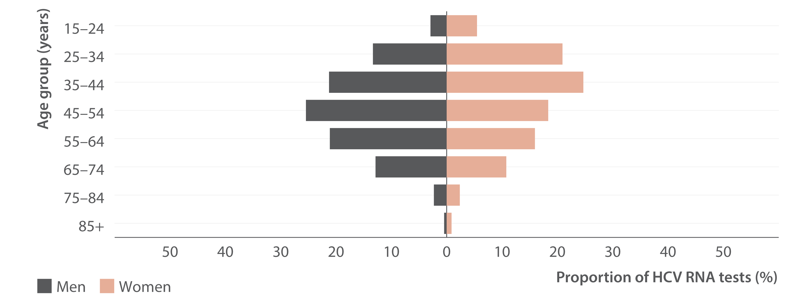
Figure 16. Proportion of claims to Medicare for items 69499 and 69500 (detection of HCV RNA, new infections only) in 2024 by age and sex
Testing and diagnosis
Source: Medicare Australia Statistics.(19)
Notes:
Notes: Denominator for proportions is all tests in 2024: n=5 838 services among women and n=8 256 services among men; only services among those aged 15 years or older shown for brevity. Medicare Benefits Schedule item numbers (69499 and 69500) are used for testing to detect current hepatitis C infection which are not used for tests associated with treatment monitoring. Prison‑based testing not included in Medicare Benefits Schedule data.

Slide 24
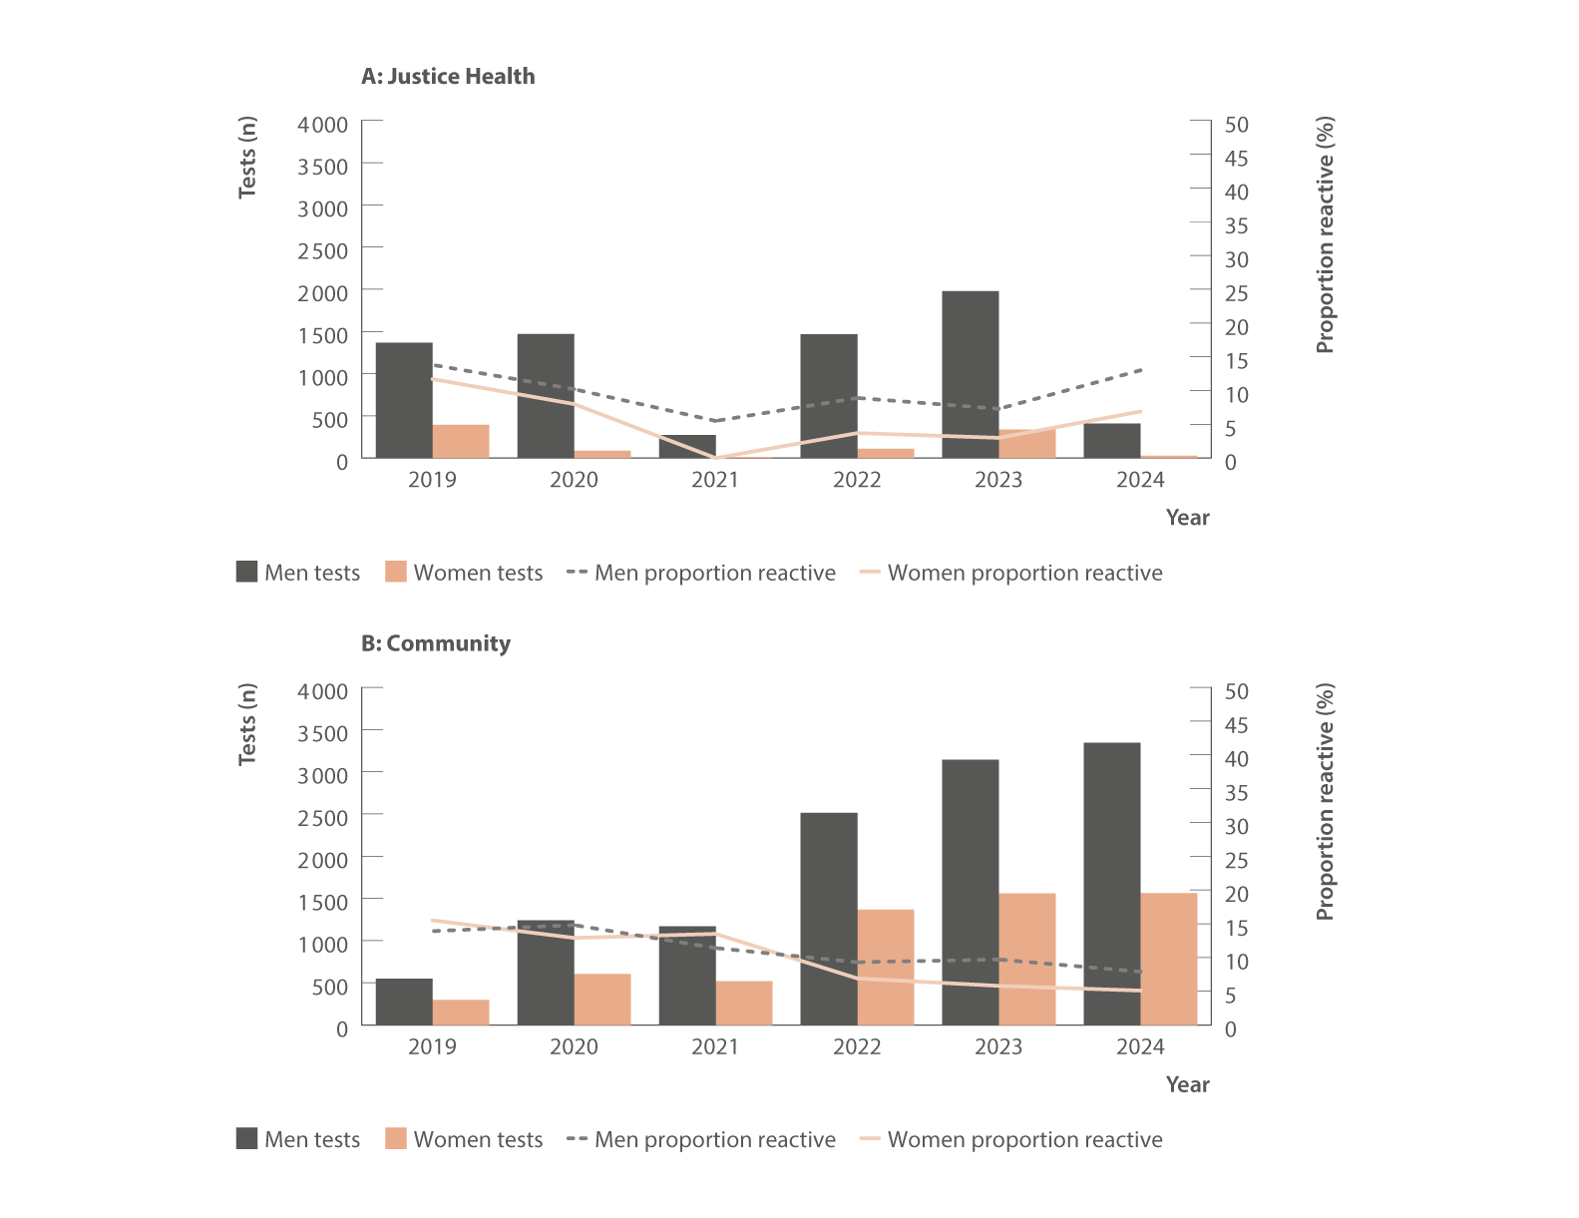
Figure 17. Number of dried blood spot tests and proportion HCV RNA reactive by (A) Justice Health and (B) community settings, NSW HIV and Hepatitis C Dried Blood Spot Testing Pilot, 2019–2024
Source: NSW HIV and Hepatitis C Dried Blood Spot Testing Pilot.(22)
Notes:
Notes: Includes valid tests completed only. Reactive result means possible HCV RNA detection; therefore active hepatitis C infection is possible but further confirmatory testing is required. People with a reactive dried blood spot result require confirmatory testing, which may be included in testing numbers from NSW Health Pathology and/or the Australian HCV Point‑of‑Care Testing Program.

Slide 25
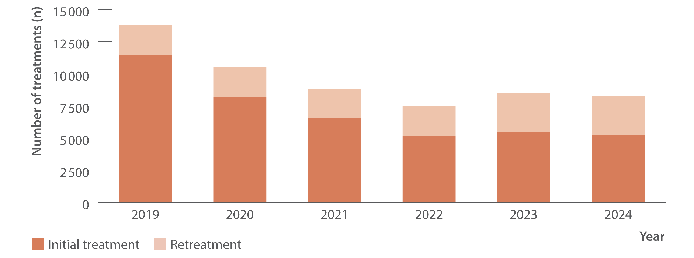
Figure 18. Total estimated DAA treatment initiations (including retreatment), PBS database, 2019–2024
Uptake of treatment
Source: Monitoring hepatitis C treatment uptake in Australia.(26)
Notes:
Notes: Treatment numbers may vary from previous or future reports due to refinements made to the PBS data between releases. Between 2016 and 2024, an estimated 111 184 people living with hepatitis C initiated treatment (first treatment). The cumulative total of treatment initiations between 2016 and 2024 was 129 233, which included 18 049 retreatments, with data from 2019 shown for brevity.

Slide 26
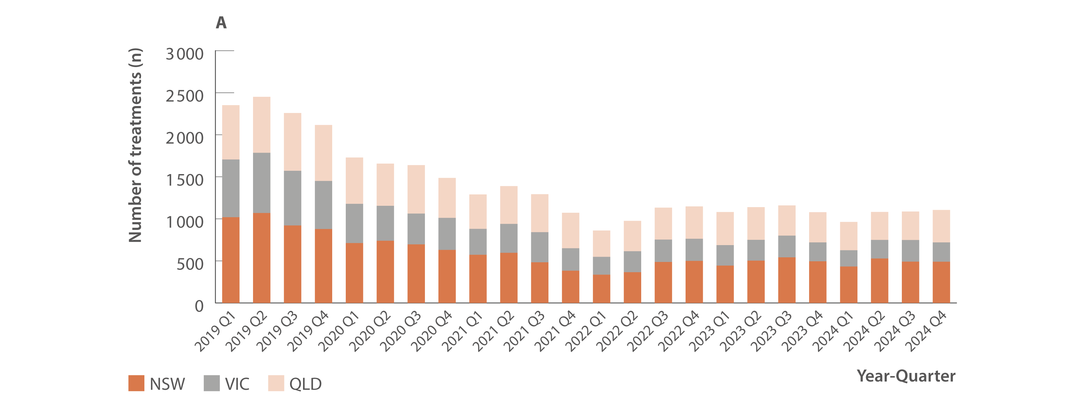
Figure 19. Estimated number of DAA treatment initiations by jurisdiction, PBS database, 2019–2024
Uptake of treatment
Source: Monitoring hepatitis C treatment uptake in Australia.(26)
Notes:
Notes: Treatment numbers may vary from previous or future reports due to refinements made to the PBS data between releases.

Slide 27
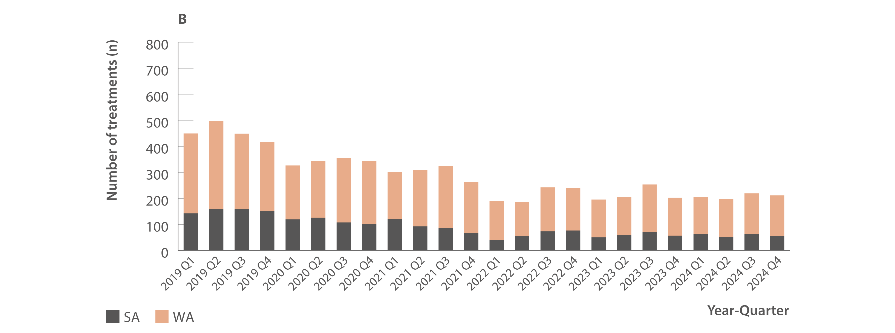
Figure 19. Estimated number of DAA treatment initiations by jurisdiction, PBS database, 2019–2024
Uptake of treatment
Source: Monitoring hepatitis C treatment uptake in Australia.(26)
Notes:
Notes: Treatment numbers may vary from previous or future reports due to refinements made to the PBS data between releases.

Slide 28
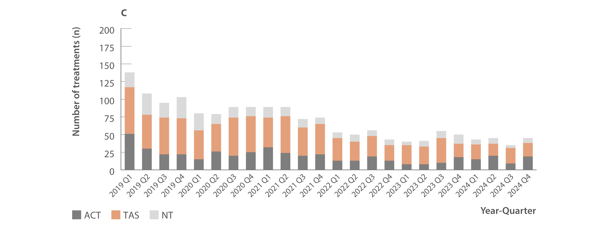
Figure 19. Estimated number of DAA treatment initiations by jurisdiction, PBS database, 2019–2024
Uptake of treatment
Source: Monitoring hepatitis C treatment uptake in Australia.(26)
Notes:
Notes: Treatment numbers may vary from previous or future reports due to refinements made to the PBS data between releases.

Slide 29
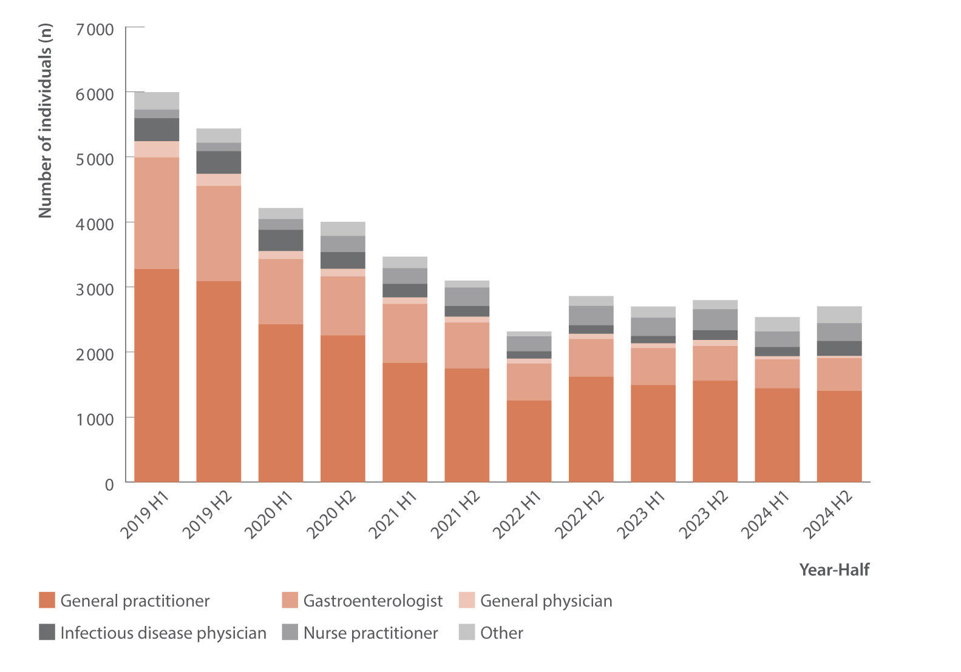
Figure 20. Estimated number of individuals initiating DAA treatment (initial treatment only) by prescriber type, PBS database, 2019–2024
Uptake of treatment
Source: Monitoring hepatitis C treatment uptake in Australia.(26)
Notes:
Notes: Treatment numbers may vary from previous or future reports due to refinements made to the PBS data between releases.

Slide 30
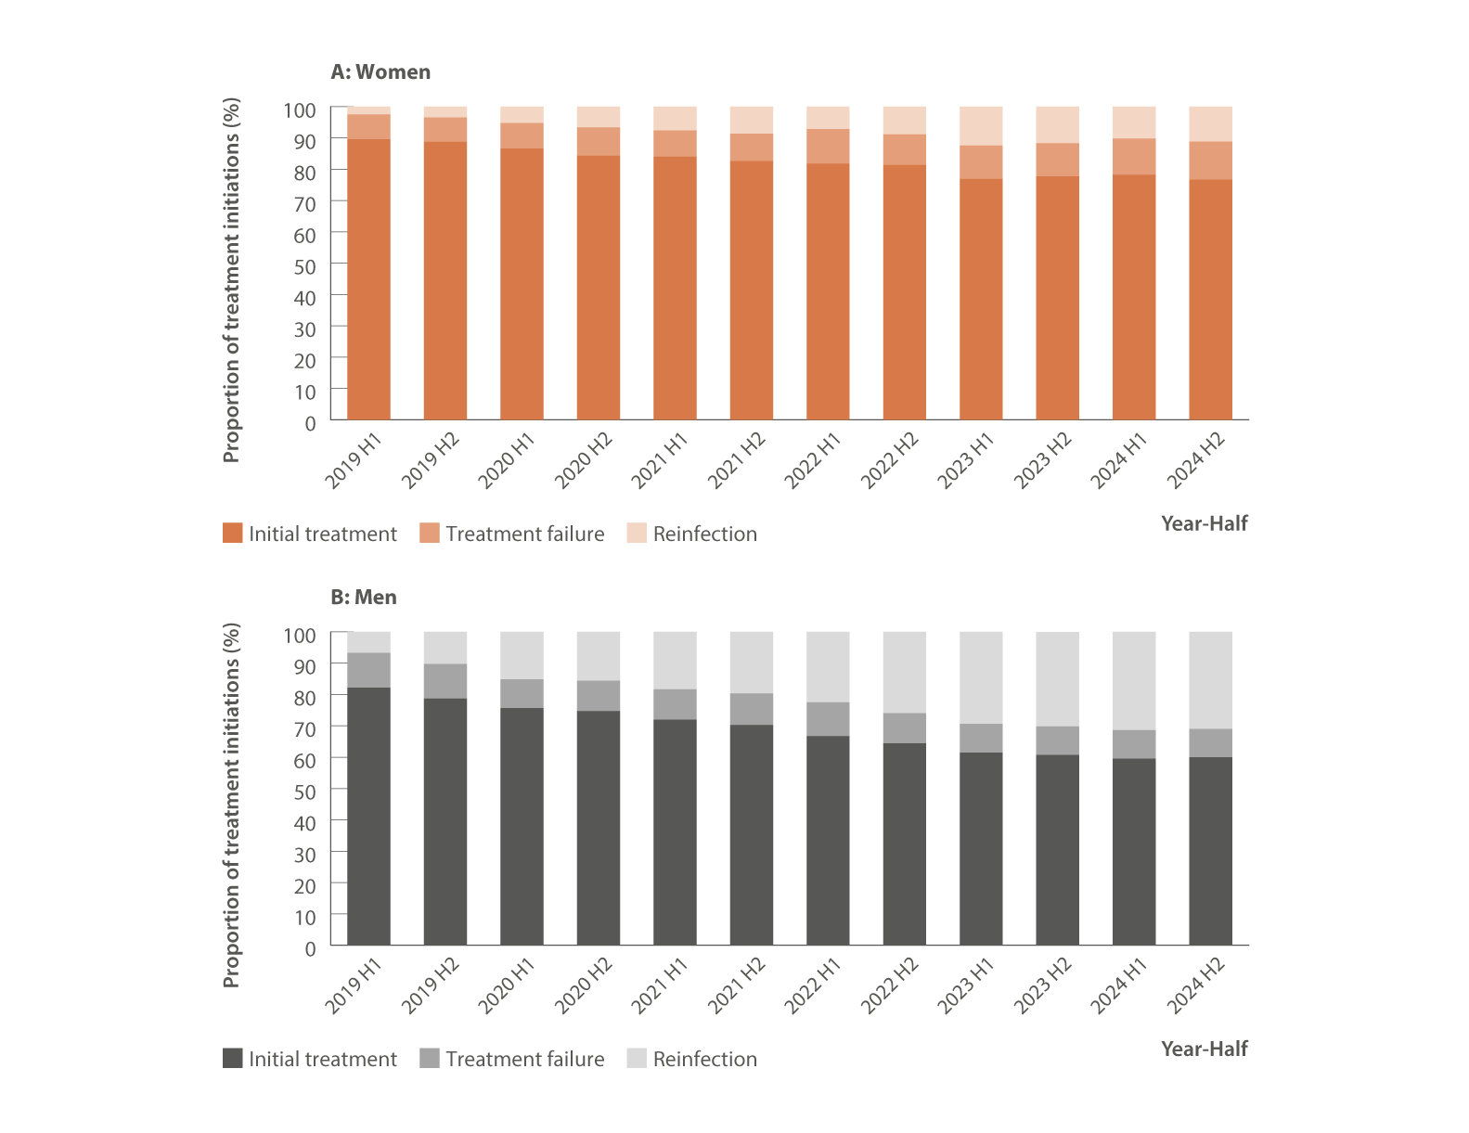
Figure 21. Estimated proportion of DAA treatment and retreatment initiations by gender, PBS database, 2019–2024
Source: Monitoring hepatitis C treatment uptake in Australia.(26)
Notes:
Notes: Treatment numbers may vary from previous or future reports due to refinements made to the PBS data between releases.

Slide 31
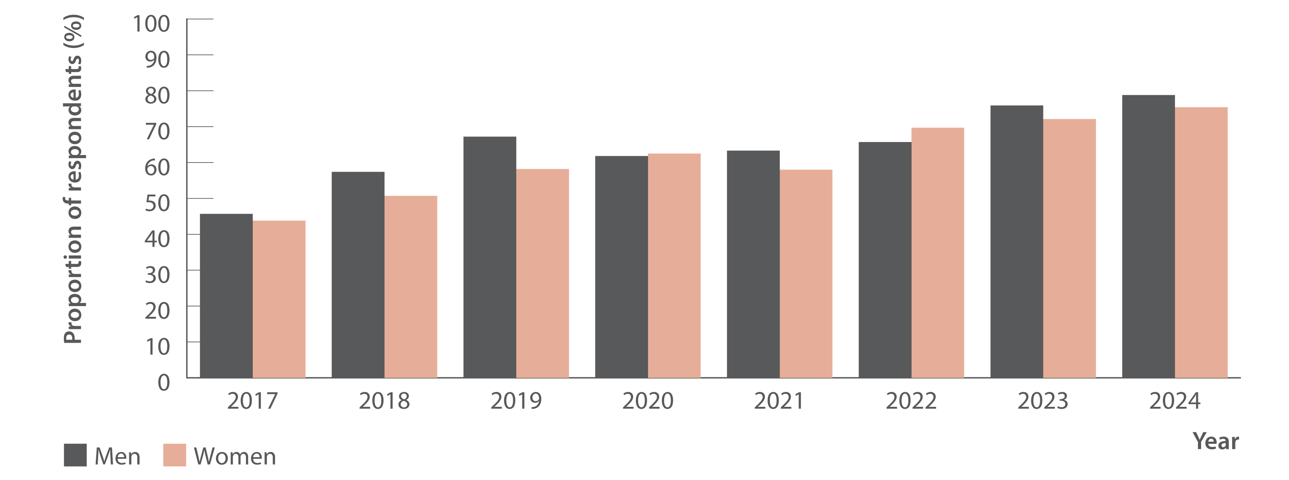
Figure 22. Proportion of Australian Needle Syringe Program Survey respondents who tested HCV antibody positive, self‑reporting lifetime history of hepatitis C treatment by gender, 2017–2024
Source: Australian NSP survey: Prevalence of HIV, HCV and injecting and sexual behaviour among NSP attendees, 30‑year National Data Report 1995–2024.(18)
Notes:
Notes: Includes respondents who tested HCV antibody positive and excludes those self‑reporting spontaneous hepatitis C clearance. No participant recruitment occurred in VIC in 2020.

Slide 32
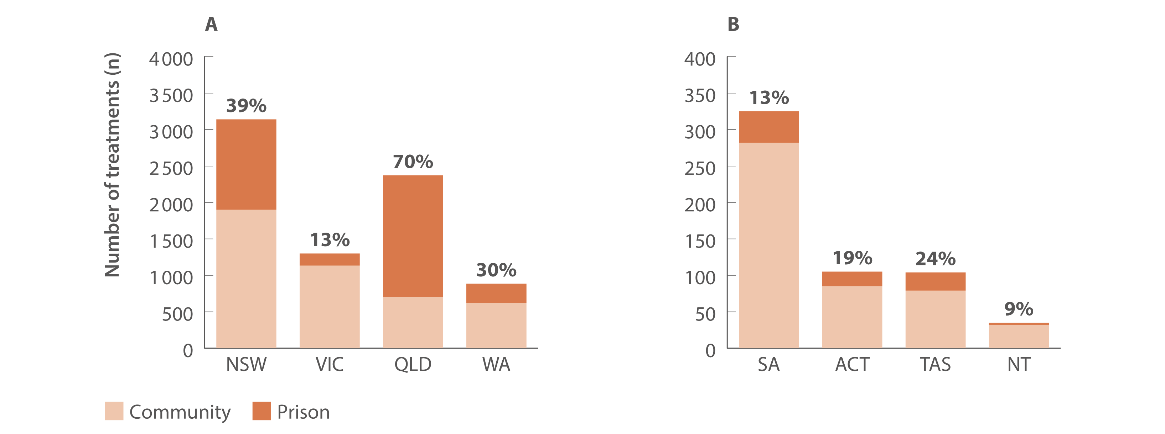
Figure 23. Number and proportion of DAA treatment initiations in prison versus in the community by jurisdiction, National Prisons Hepatitis Network and PBS database, 2024
Source: State and Territory justice health authorities via the National Prisons Hepatitis Network.(20) Monitoring treatment uptake in Australia.(26)
Notes:
Notes: *Number of adult prisons in the jurisdiction. †Data were collected from 36 prisons. ‡Data were collected from 13 prisons. The proportion of treatment initiations in prisons nationally was calculated using the total number of treatment initiations (i.e., treatment courses) reported by jurisdictional hepatitis services as a proportion of all treatments derived from the PBS database. ‘Community’ treatment initiations are therefore defined as all treatment initiations in the PBS database minus all treatments reported by jurisdictional prison hepatitis services. For individuals who received treatment, individuals were counted once per year and treatment may be first treatment or retreatment.

Slide 33
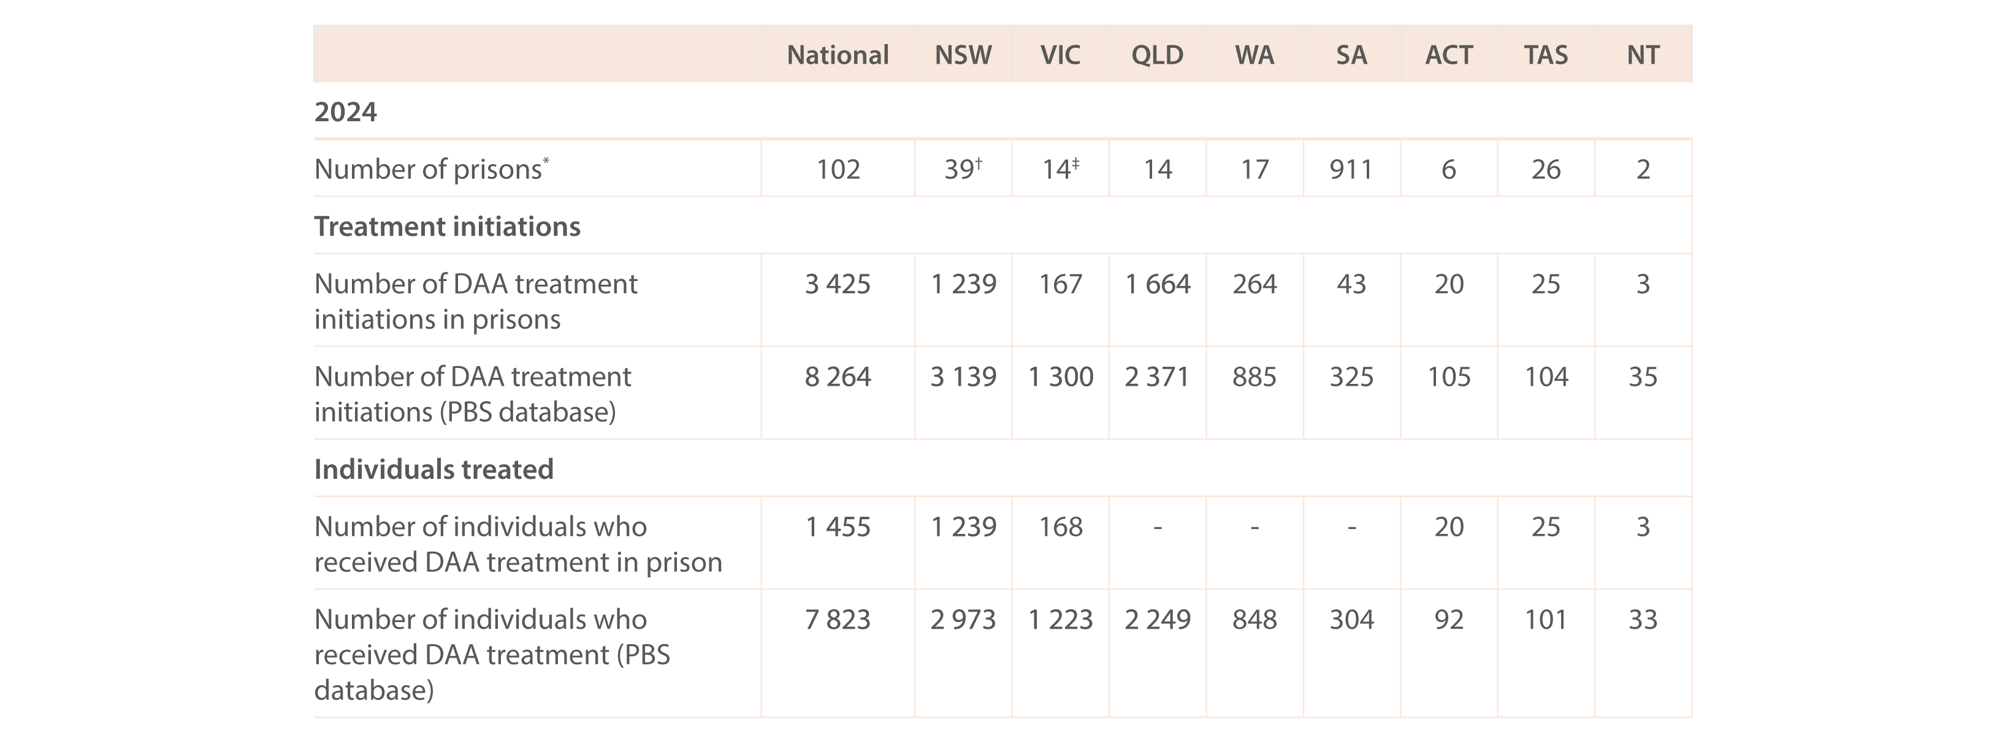
Table 1. Number of individuals who received DAA treatment and DAA treatment initiations in prison versus in the community, nationally and by jurisdiction, National Prisons Hepatitis Network and PBS database, 2024
Uptake of treatment
Source: State and Territory justice health authorities via the National Prisons Hepatitis Network.(20) Monitoring treatment uptake in Australia.(26)
Notes:
Notes: *Number of adult prisons in the jurisdiction. †Data were collected from 36 prisons. ‡Data were collected from 13 prisons. The proportion of treatment initiations in prisons nationally was calculated using the total number of treatment initiations (i.e., treatment courses) reported by jurisdictional hepatitis services as a proportion of all treatments derived from the PBS database. ‘Community’ treatment initiations are therefore defined as all treatment initiations in the PBS database minus all treatments reported by jurisdictional prison hepatitis services. For individuals who received treatment, individuals were counted once per year and treatment may be first treatment or retreatment.

Slide 34
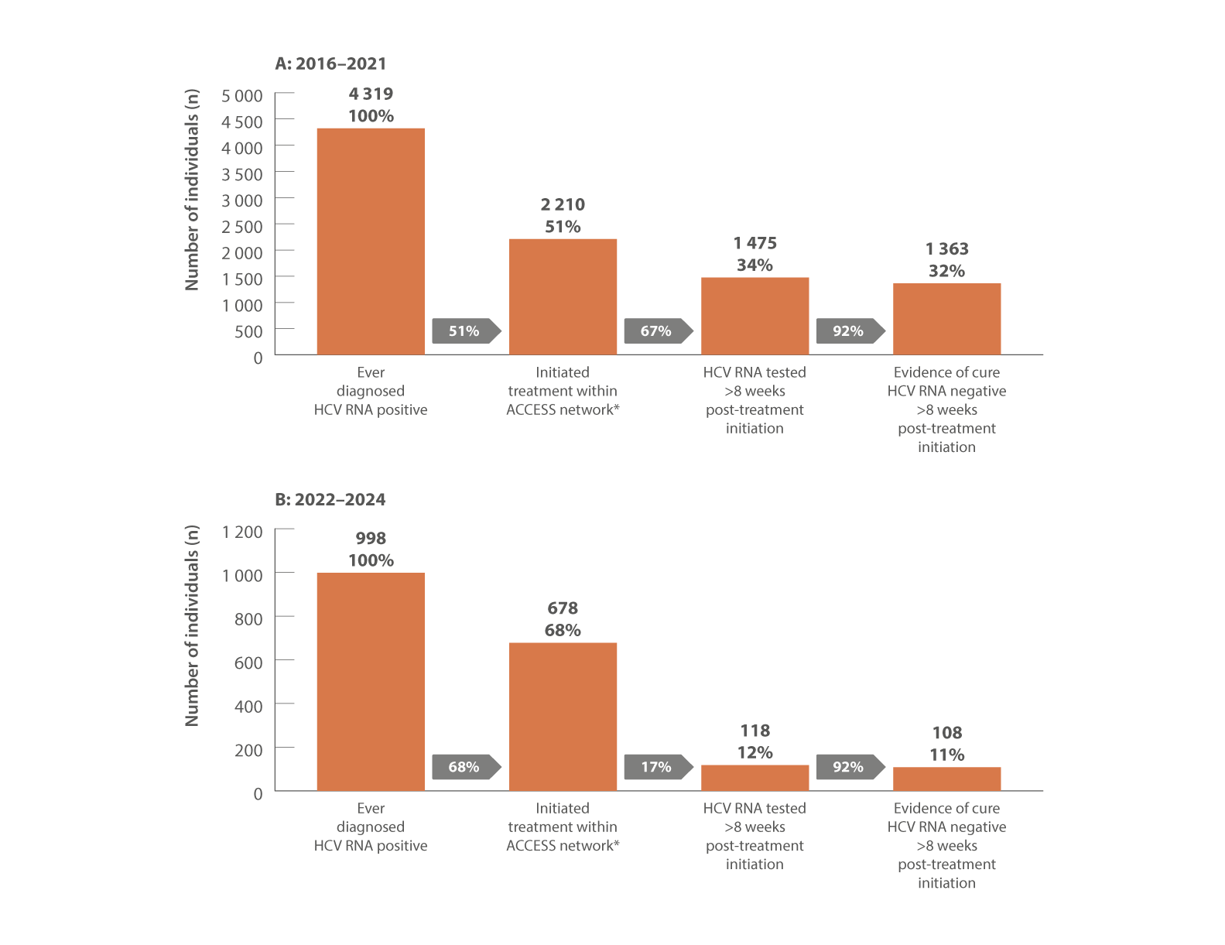
Figure 24. Hepatitis C treatment cascade at ACCESS primary care clinics: number of individuals hepatitis C diagnosed, number and proportion of individuals who initiated treatment, and tested for HCV RNA post‑treatment initiation, (A) 2016–2021 and (B) 2022–2024
Source: ACCESS.(13) Updated from Traeger et al., PLoS One 2020.(30)
Notes:
Notes: Cascade includes individuals attending ACCESS primary care clinics (same primary care clinics as other ACCESS sections in report) with evidence of a consult recorded in ACCESS before 2016. Figure A is restricted to individuals who were diagnosed HCV RNA positive between 01 March 2016 and 31 December 2021 and reflects the status of individuals on 31 December
2021. Figure B is restricted to individuals who were diagnosed HCV RNA positive between 01 January 2022 and 31 December 2024 and reflects the status of individuals on 31 December 2024. *Treatment initiation was indicated by the presence of an electronic medical record of a prescription of DAA therapy recorded at an ACCESS clinic. Individuals were assumed to have progressed through preceding cascade stages if evidence of reaching a subsequent stage was present.

Slide 35
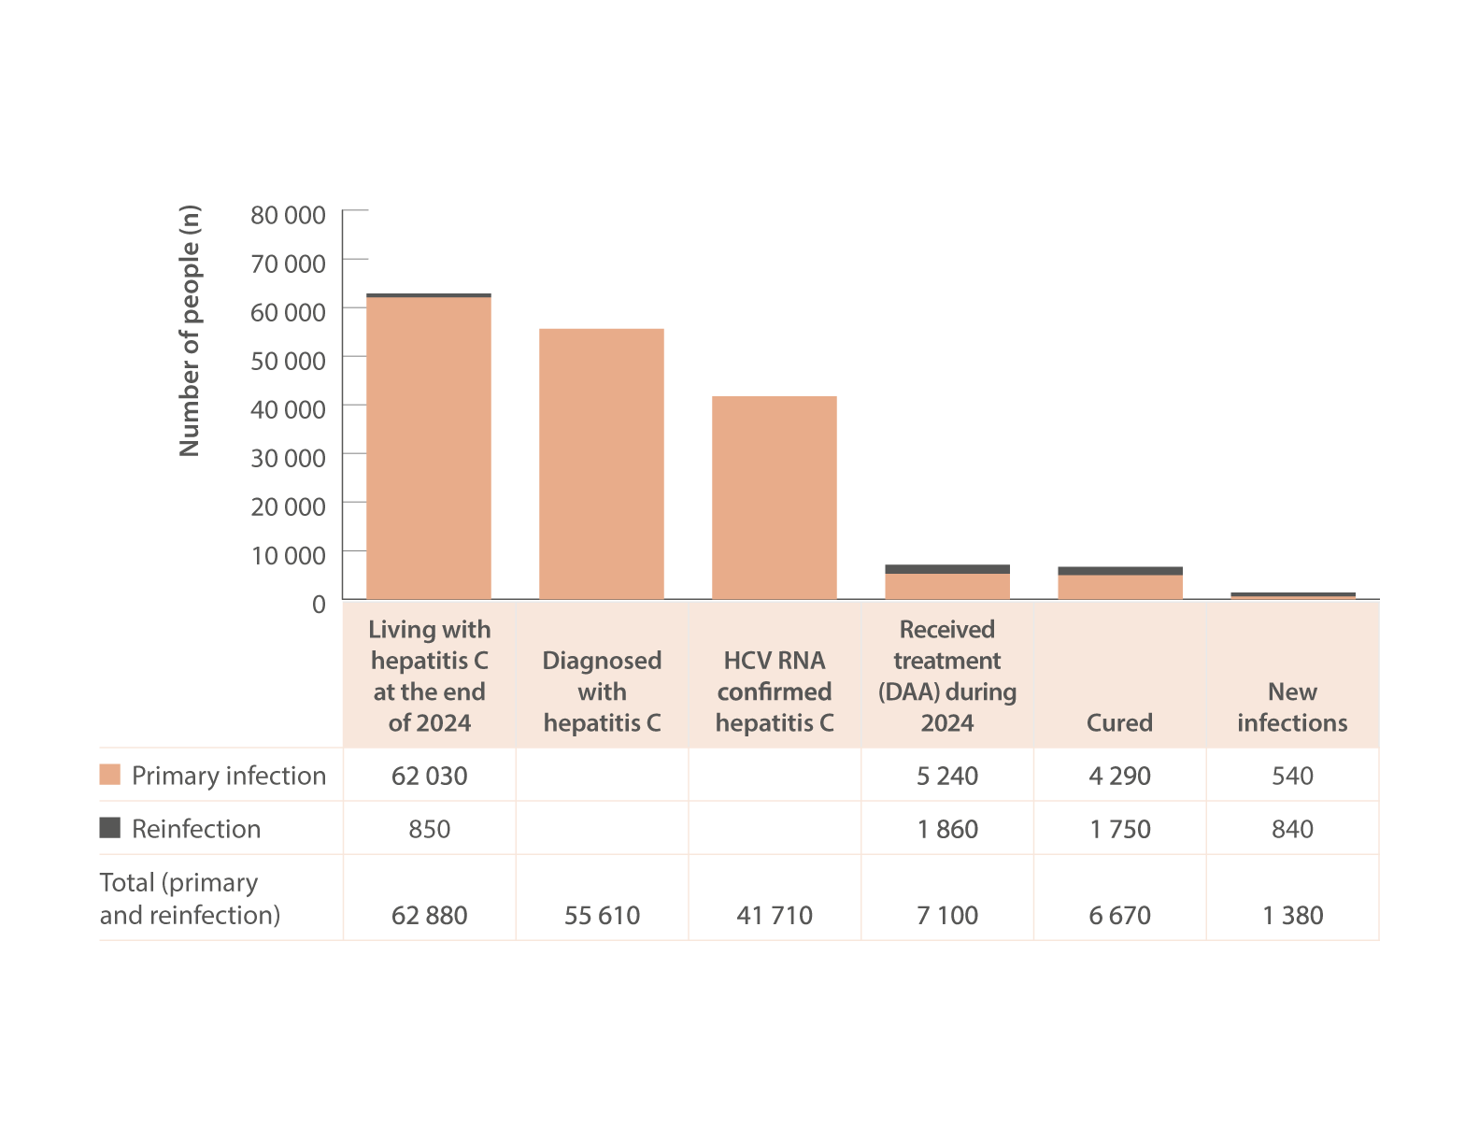
Figure 25. The 2024 hepatitis C diagnosis and care cascade, HIV, viral hepatitis and sexually transmissible infections in Australia, Annual Surveillance Report
Source: Updated by Kirby Institute, from the HIV, viral hepatitis and sexually transmissible infections in Australia: annual surveillance report 2024.(4,9,10)
Notes:
Notes: Numbers in the cascade rounded for clarity. The care cascade was estimated using mathematical modelling; mathematical modelling uses available data from observational research studies and administrative datasets to derive estimates like the population prevalence of hepatitis C, accounting for uncertainties. Living with hepatitis C is the estimated number of individuals in the overall population who had detectable HCV RNA in 2024; diagnosed with hepatitis C infection is the estimated number of individuals living with chronic hepatitis C in 2024 who have been previously diagnosed (HCV antibody positive or HCV RNA); HCV RNA confirmed hepatitis C is the estimated number of individuals who are confirmed with hepatitis C from HCV RNA testing; received DAA treatment is the observed number of individuals who received initial treatment in 2024 and a modelled estimate of individuals who received treatment for reinfection; and cured is the estimated number of treated individuals who achieved undetectable HCV RNA post‑treatment in 2024.

Slide 36
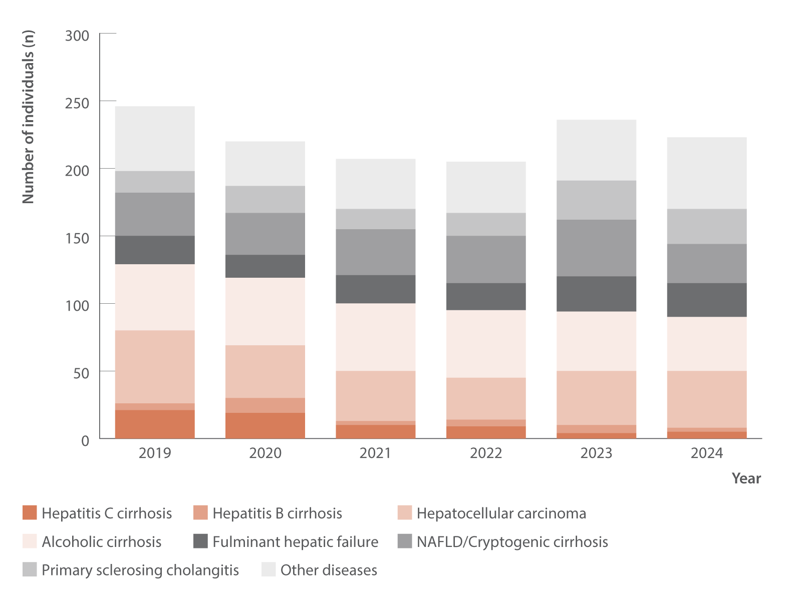
Figure 26. Number of Australian adult liver transplant recipients by primary diagnosis and year of first transplant, Australia and New Zealand Liver and Intestinal Transplant Registry, 2019–2024
Morbidity
Source: Australia and New Zealand Liver and Intestinal Transplant Registry.(36)
Notes:
Notes: Australian transplant recipients only. Adults defined as 16 years or older. NAFLD: non‑alcoholic fatty liver disease.

Slide 37
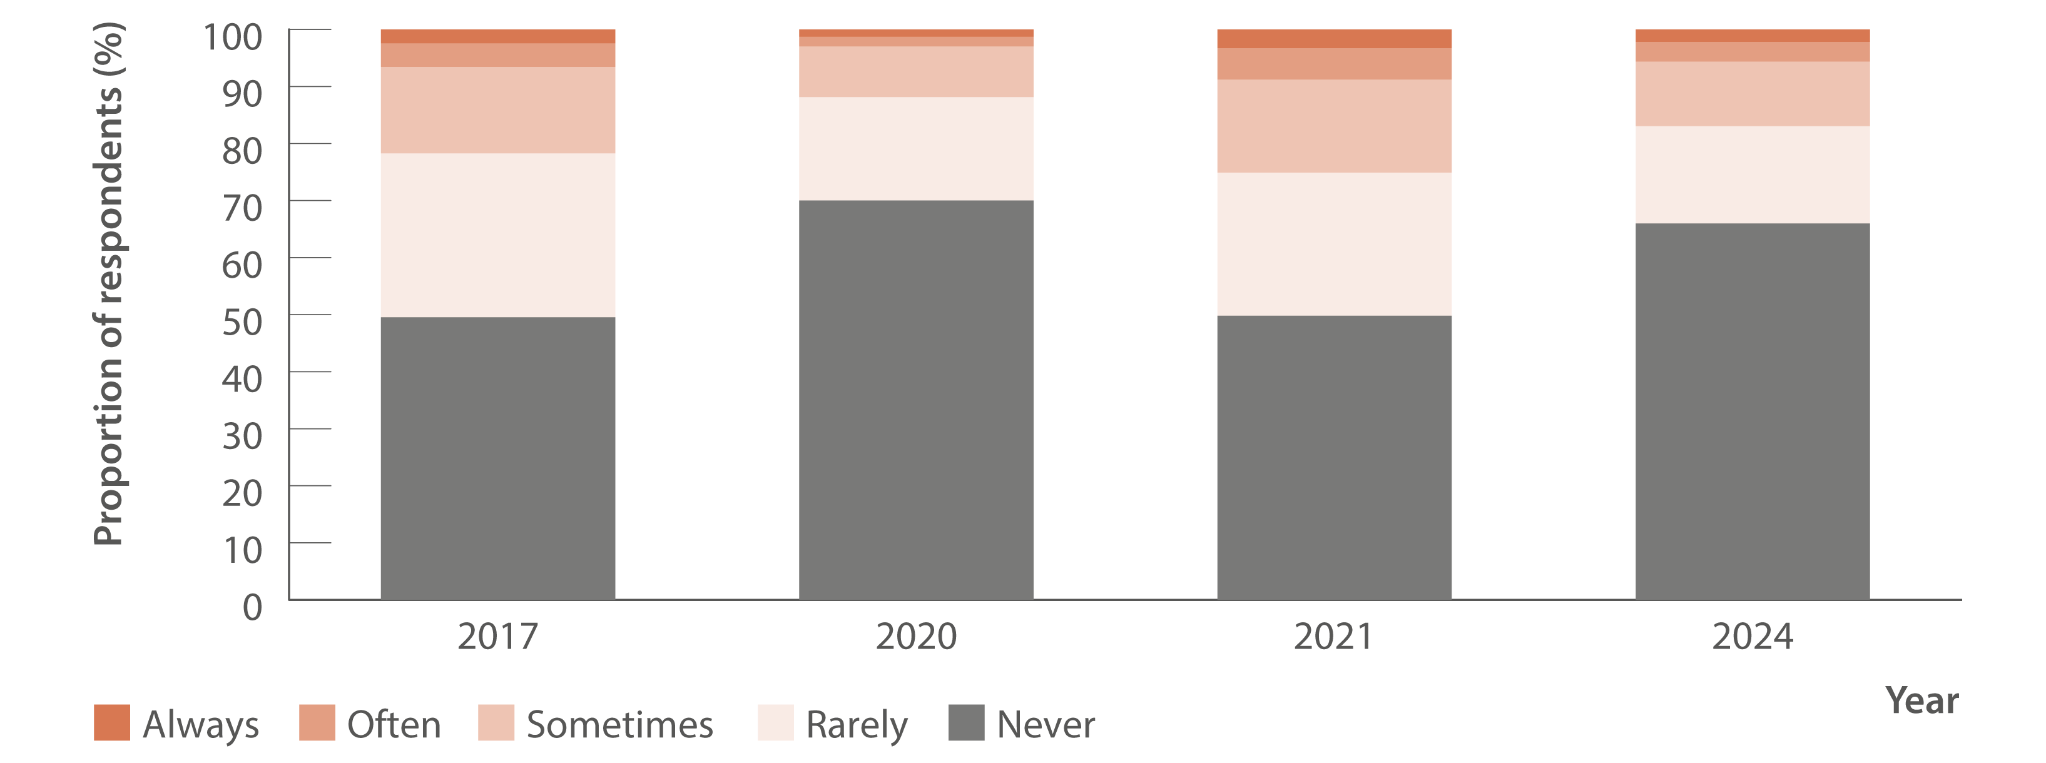
Figure 27. Reports of negative behaviour towards other people because of their hepatitis C by the general public, 2017–2024
Stigma and discrimination
Source: Stigma Indicators Monitoring Project.(41)

Slide 38
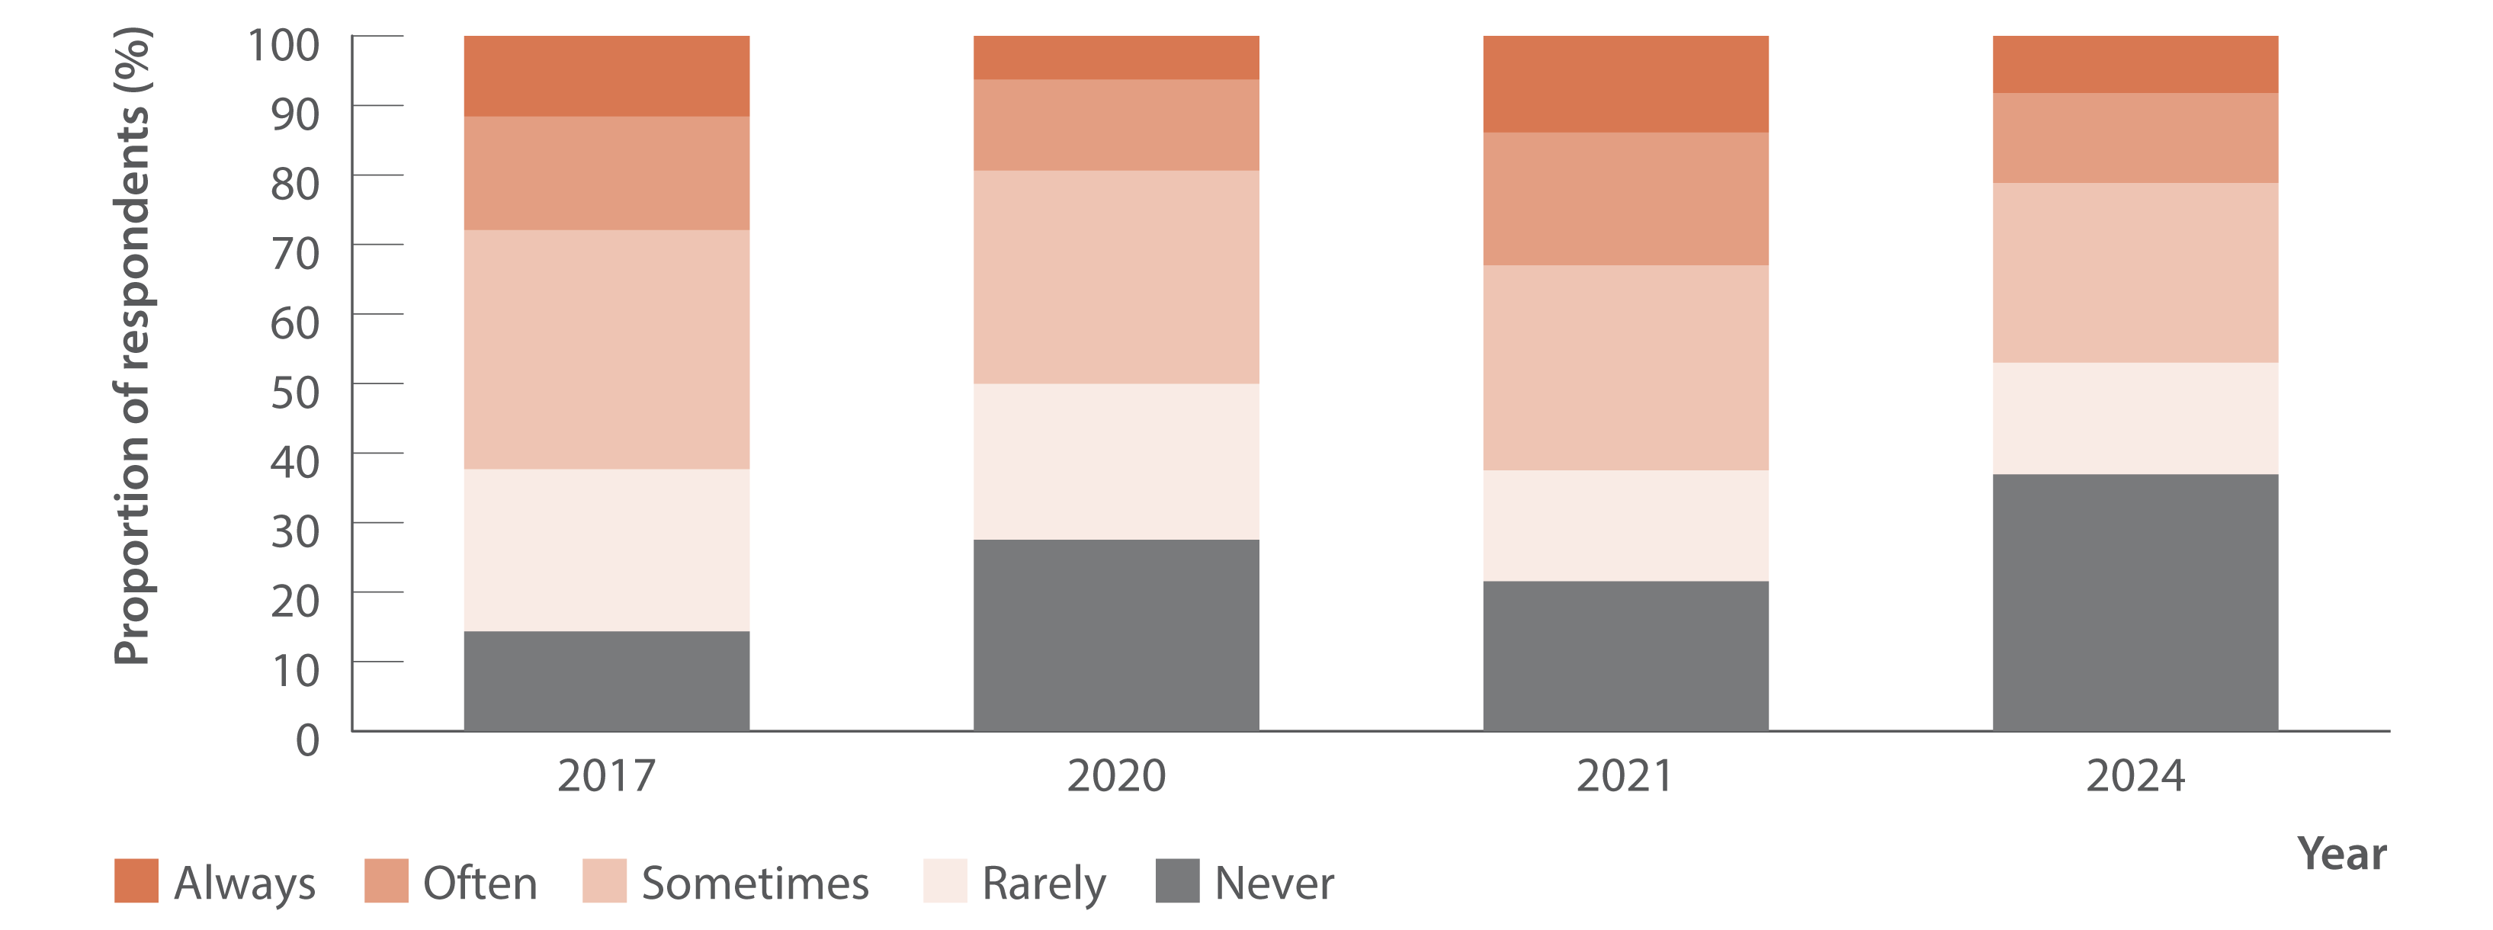
Figure 28. Reports of negative behaviour towards other people because of their injecting drug use by the general public, 2017–2024
Stigma and discrimination
Source: Stigma Indicators Monitoring Project.(41)

Slide 39
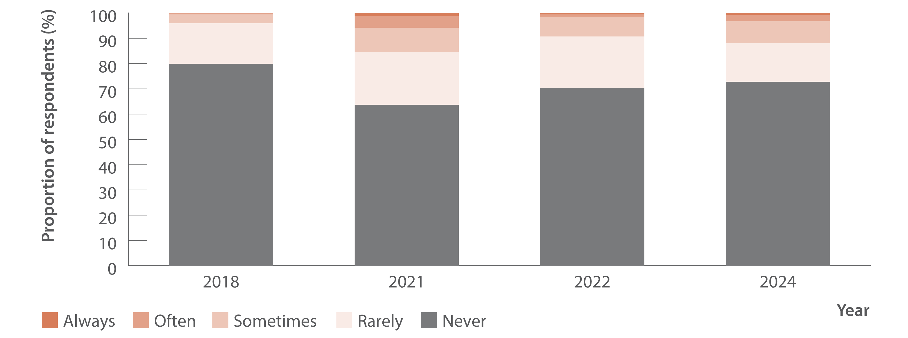
Figure 29. Reports of negative behaviour towards other people because of their hepatitis C by healthcare workers, 2018–2024
Stigma and discrimination
Source: Stigma Indicators Monitoring Project.(42)

Slide 40
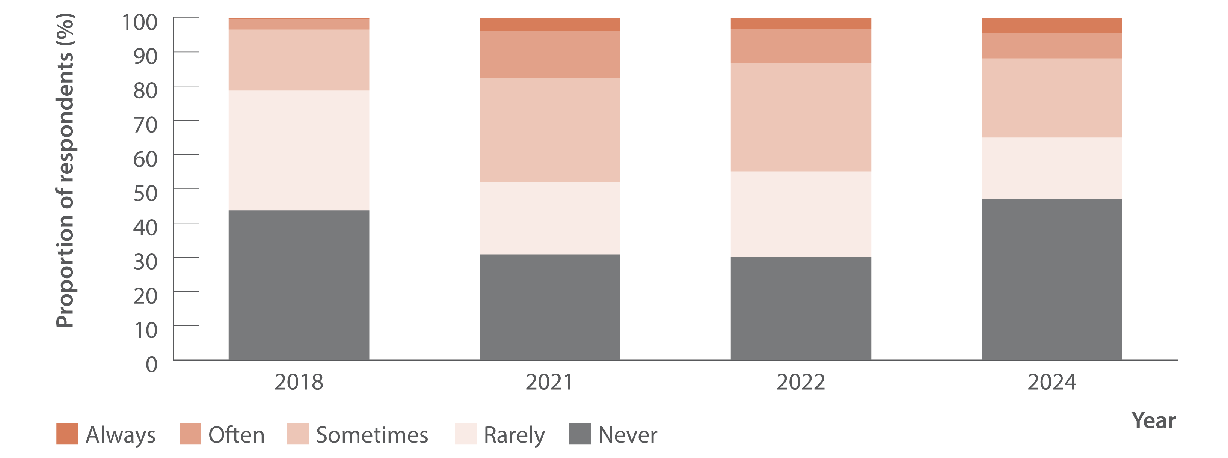
Figure 30. Reports of negative behaviour towards other people because of their injecting drug use by healthcare workers, 2018–2024
Stigma and discrimination
Source: Stigma Indicators Monitoring Project.(42)

Slide 41
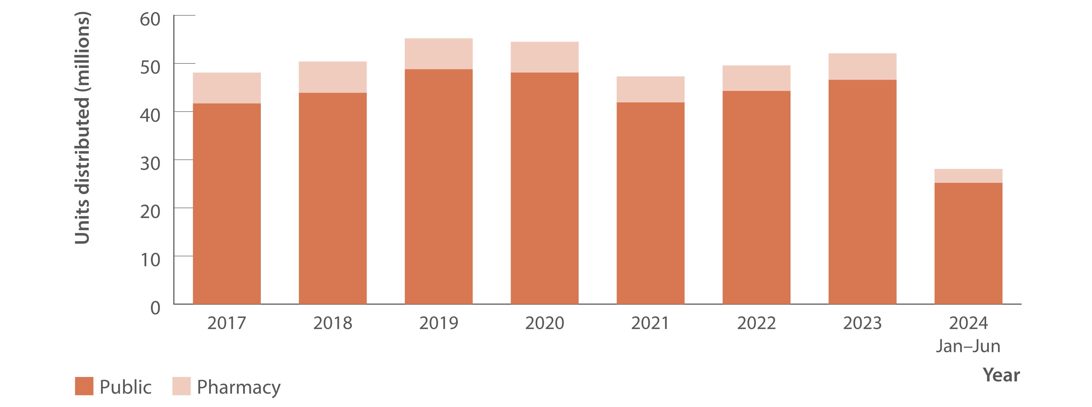
Figure 31. Number of needle and syringe units distributed by public and pharmacy sector, Needle Syringe Program National Minimum Data Collection, 2017–June 2024
Prevention
Source: Needle Syringe Program National Minimum Data Collection: National Data Report 2024.(43)
Notes:
Notes: July–December 2024 data not available at the time of reporting.

Slide 42
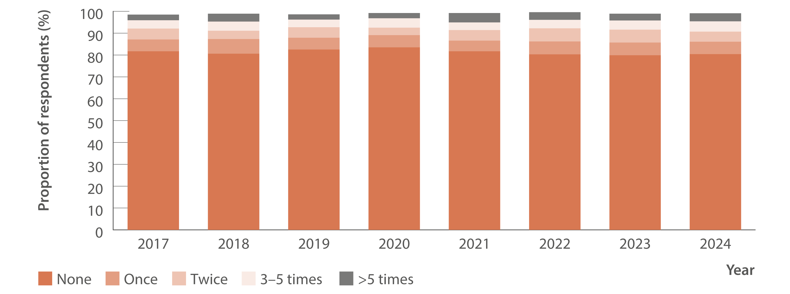
Figure 32. Proportion of Australian Needle Syringe Program Survey respondents reporting re‑use of someone else’s needles and syringes in the past month, 2017–2024
Source: Australian NSP survey: Prevalence of HIV, HCV and injecting and sexual behaviour among NSP attendees, 30‑year National Data Report 1995–2024.(18)
Notes:
Notes: Not reported not included. Injection risk behaviour variables are presented among those who injected in the previous month, not the entire sample. For 2017 to 2024, sample size was (in order): 2 314, 2 452, 2 333, 1 173, 1 259, 1 581, 1 748,
and 1 588.

Slide 43
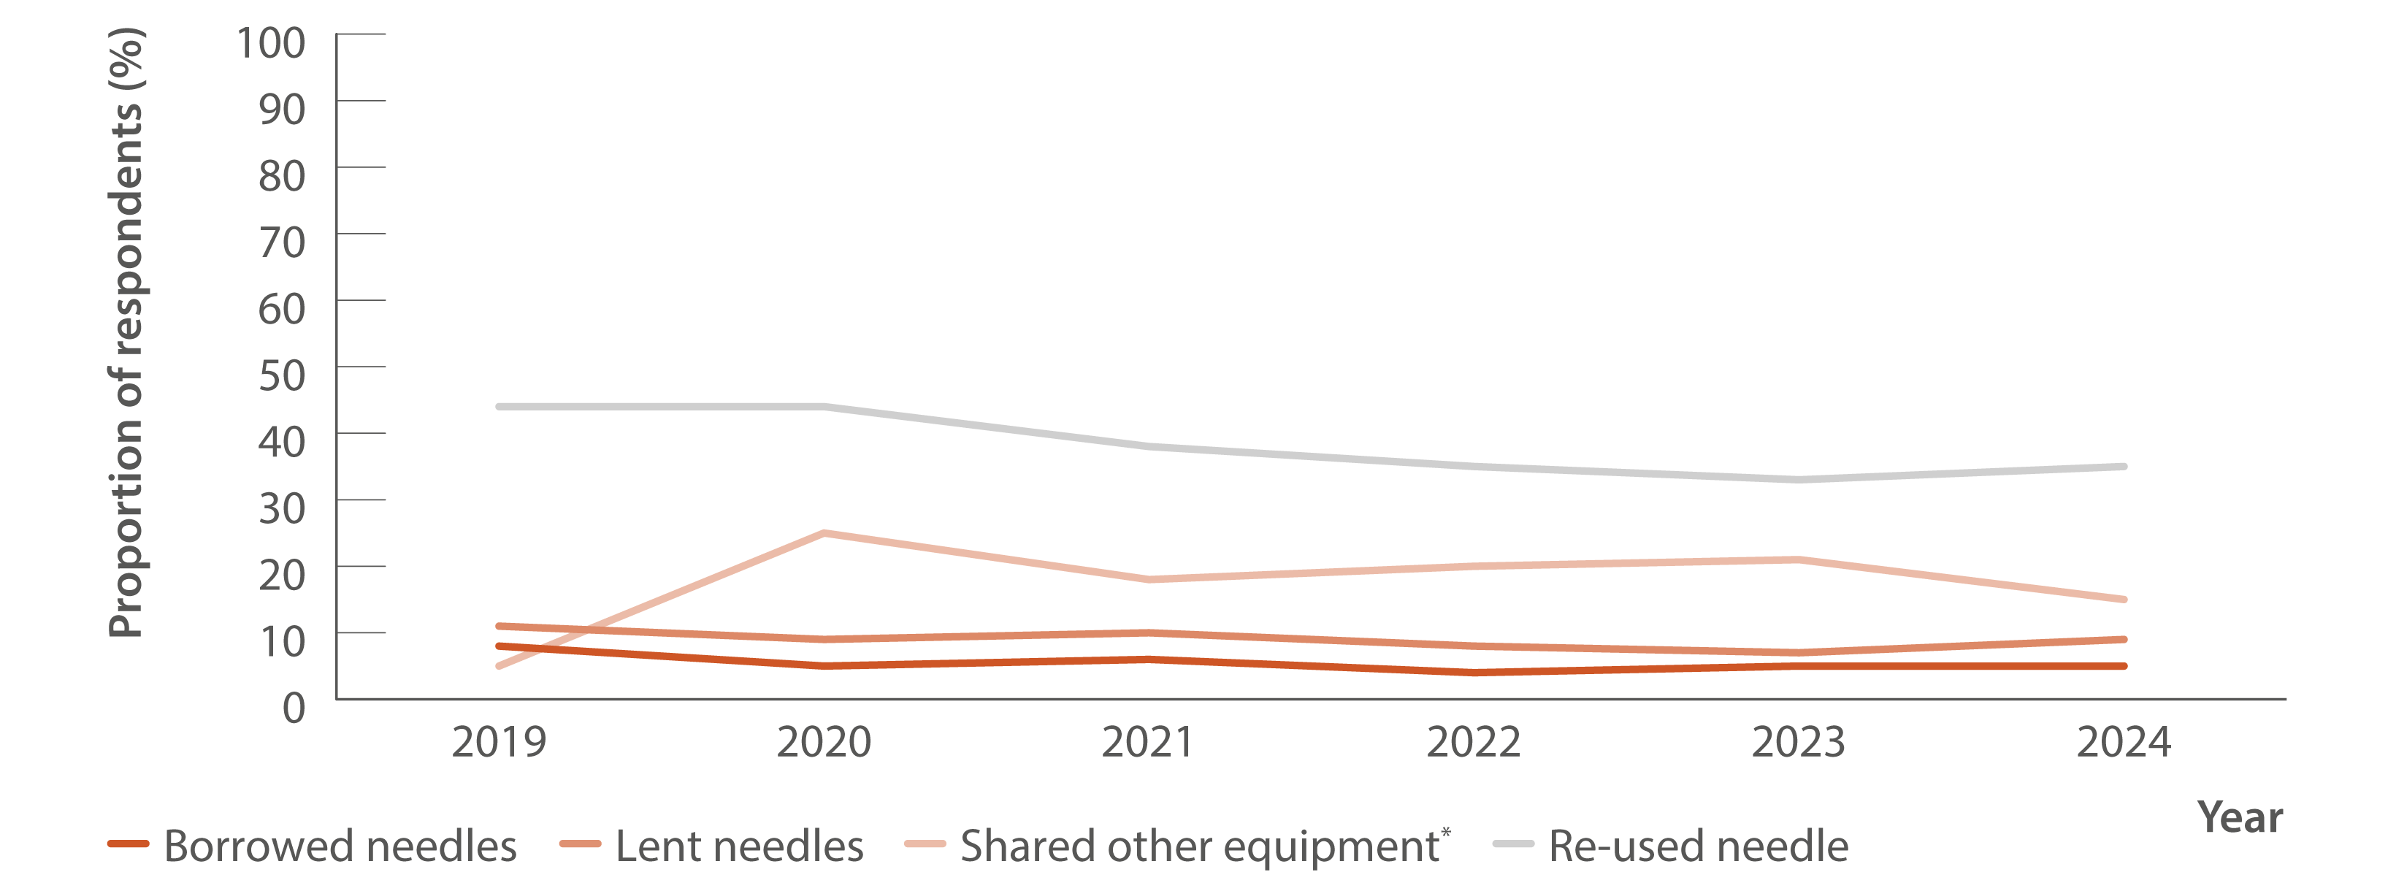
Figure 33. Proportion of respondents reporting borrowing and lending of needles, sharing of injecting equipment, and re‑use of needles in the past month, national, Illicit Drug Reporting System, 2019–2024
Source: Australian Drug Trends 2024: key findings from the National Illicit Drug Reporting System (IDRS) Interviews.(47)
Notes:
Notes: *Includes spoons, water, tourniquets, and filters. Lent (distributive) needles’ is where someone used a needle after them. Borrowed (receptive) needles’ is using a needle after someone else.

Slide 44
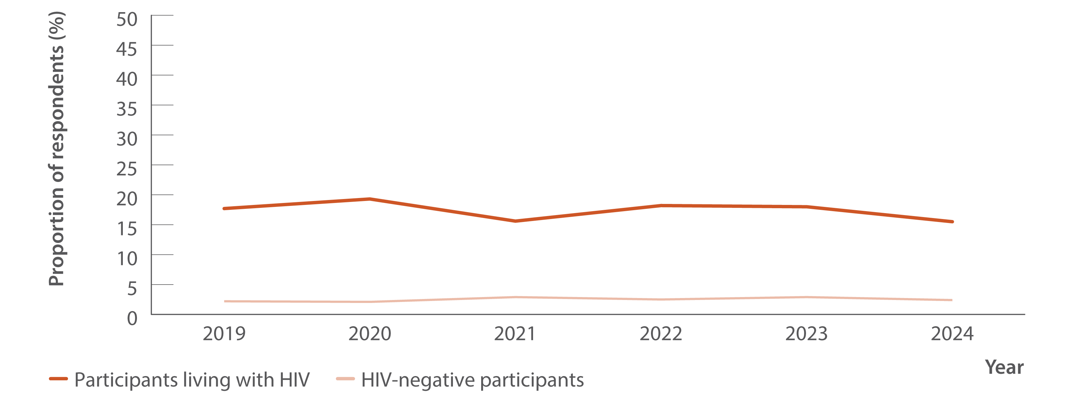
Figure 34. Proportion of participants who reported any drug injection in the six months prior to the survey by HIV status, national, GBQ+ Community Periodic Survey, 2019–2024
Source: Annual Report of Trends in Behaviour 2024: HIV and STIs in Australia.(48,49)
Notes:
Notes: Unadjusted data.

Slide 45
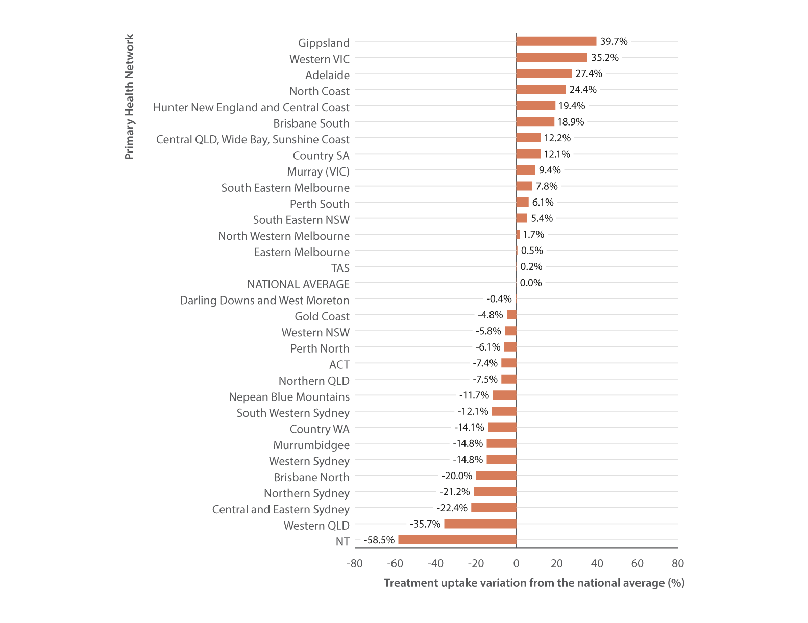
Figure 35. Hepatitis C treatment uptake variation compared to the national average by PHN, March 2016–June 2024
Equity
Source: The National Viral Hepatitis Mapping Project (WHO Collaborating Centre for Viral Hepatitis, The Doherty Institute).(50)
Notes:
Notes: Hepatitis C treatment uptake variation estimates based on treatment (PBS) data sourced from Medicare statistics and hepatitis C notifications according to geographic region.

Slide 46
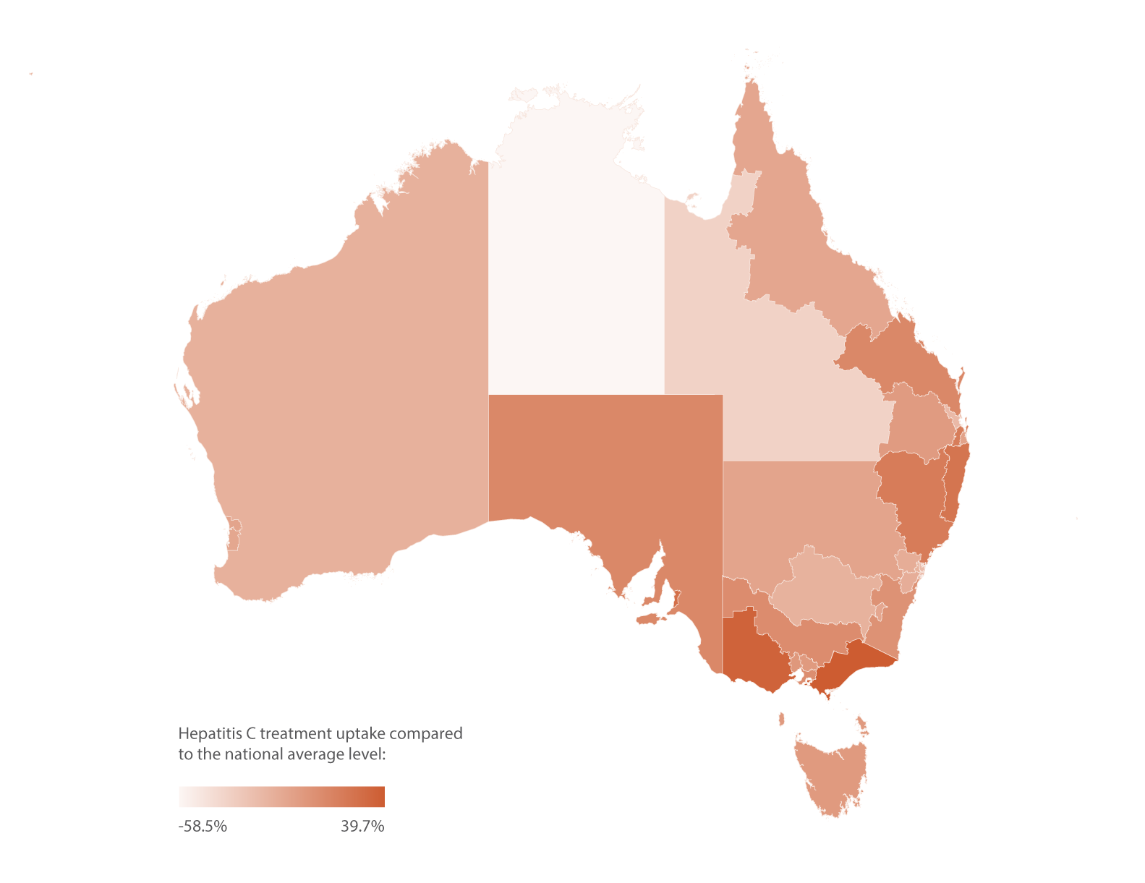
Figure 36. Geographic variation in hepatitis C treatment uptake, March 2016–June 2024
Equity
Source: The National Viral Hepatitis Mapping Project (WHO Collaborating Centre for Viral Hepatitis, The Doherty Institute).(50)
Notes:
Notes: Hepatitis C treatment uptake variation estimates based on treatment data (PBS database) sourced from Medicare statistics and hepatitis C notifications according to geographic region.

Slide 47
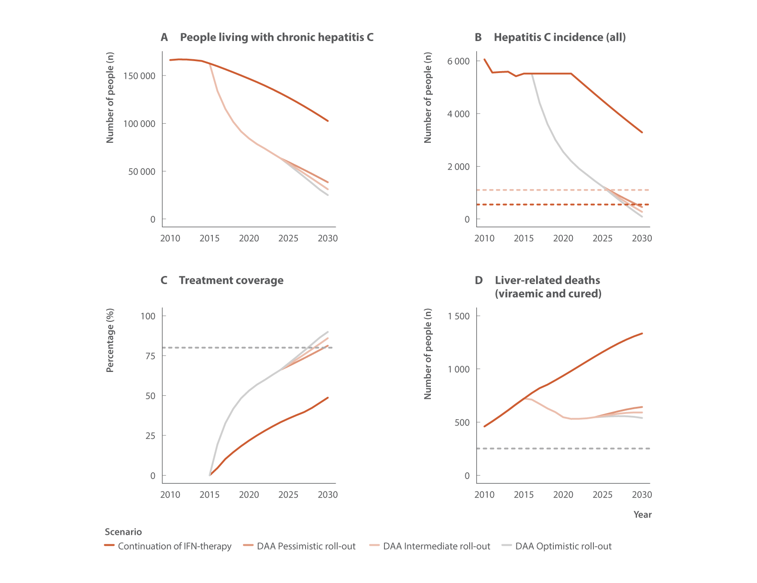
Figure 37. Annual change in people living with chronic hepatitis C, hepatitis C incidence (all), treatment coverage, and liver‑related deaths (viraemic and cured) in Australia 2030 (2010–2030) with WHO HCV elimination targets (dotted lines: Panel B: 80% and 90% reductions in incidence, Panel C: 80% eligible treated, and Panel D: 65% reduction in deaths)
Modelling elimination
Source: Updated from Kwon et al., J Viral Hepat 2019(9) and Kwon et al., PLoS One 2021.(10)
Notes:
Notes: The assumed pessimistic roll‑out scenario corresponds to 25% less people being treated with DAA therapy than 2024, an intermediate roll‑out scenario corresponds to the annual number treated equalling the number in 2024, and an optimistic scenario where the annual number treated increased 25% more than the 2024 level. The annual number of people treated for all three scenarios in the earlier years is as follows: 2015 (interferon plus DAA): 4 720; 2016: 33 458; 2017: 21 249; 2018: 15 355; 2019: 11 433; and 2020: 8 215.

Slide 48
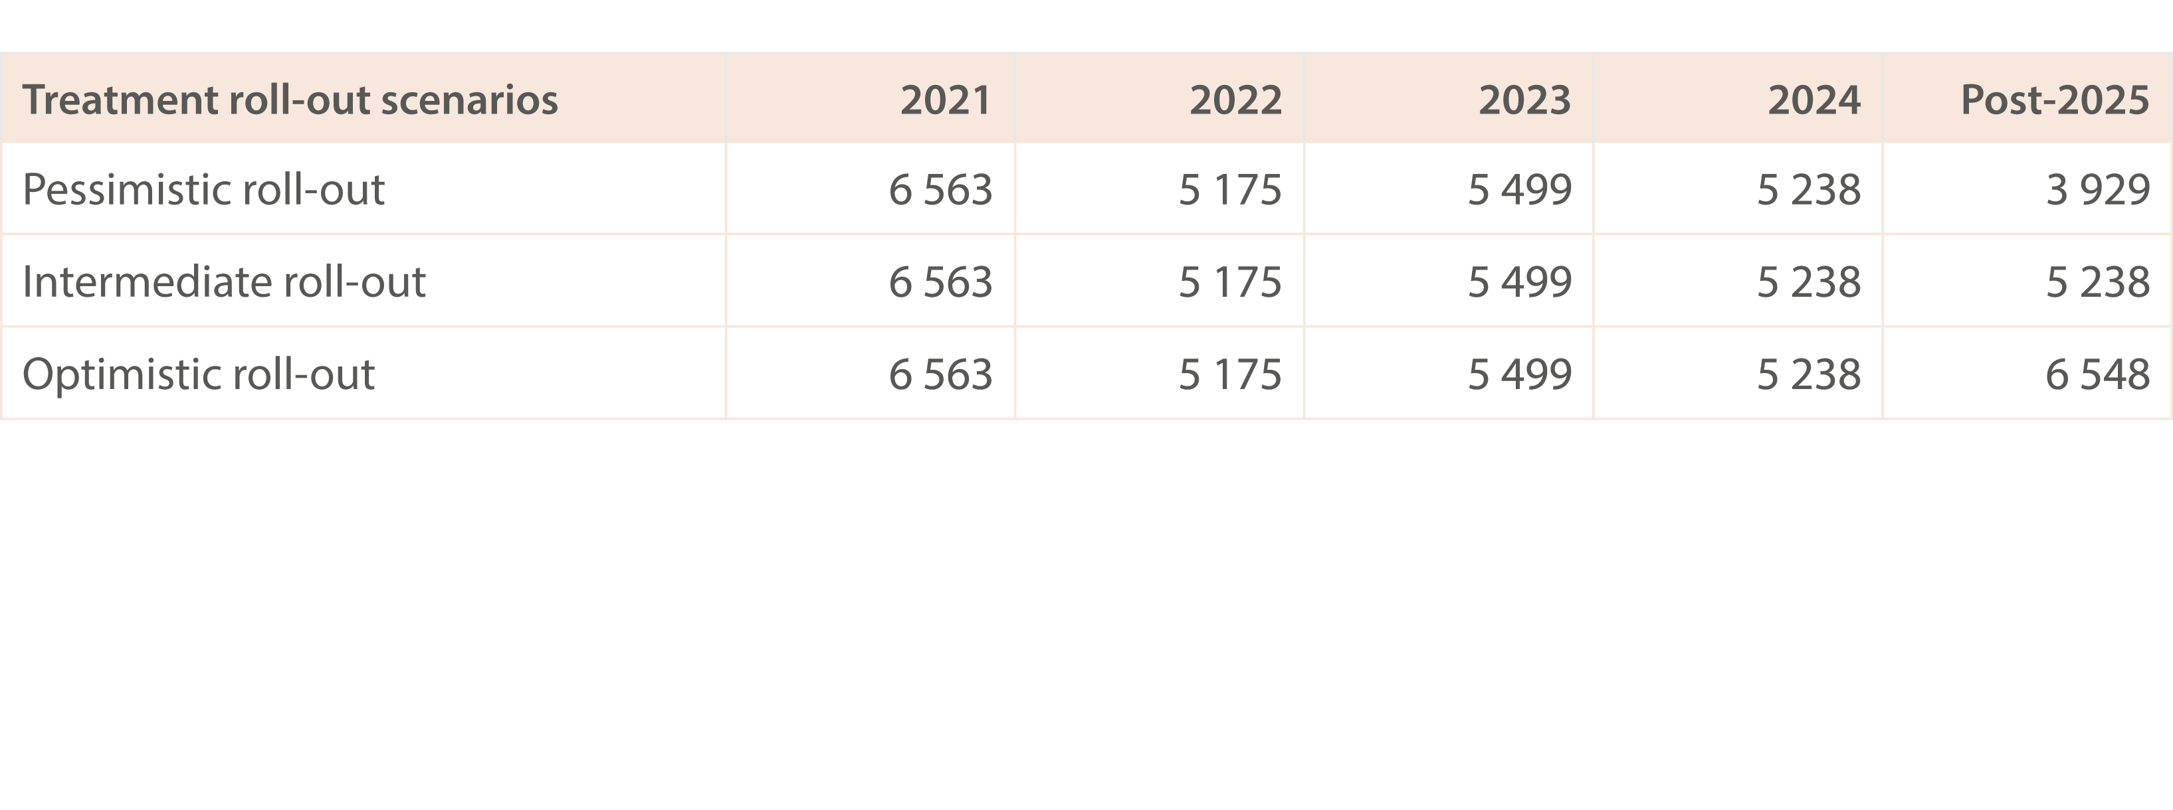
Table 2. Scenarios for the annual number of people in Australia receiving DAA
Modelling elimination
Source: Updated from Kwon et al., J Viral Hepat 2019(9) and Kwon et al., PLoS One 2021.(10)
Notes:
Notes: The assumed pessimistic roll‑out scenario corresponds to 25% less people being treated with DAA therapy than 2024, an intermediate roll‑out scenario corresponds to the annual number treated equalling the number in 2024, and an optimistic scenario where the annual number treated increased 25% more than the 2024 level. The annual number of people treated for all three scenarios in the earlier years is as follows: 2015 (interferon plus DAA): 4 720; 2016: 33 458; 2017: 21 249; 2018: 15 355; 2019: 11 433; and 2020: 8 215.

Slide 49
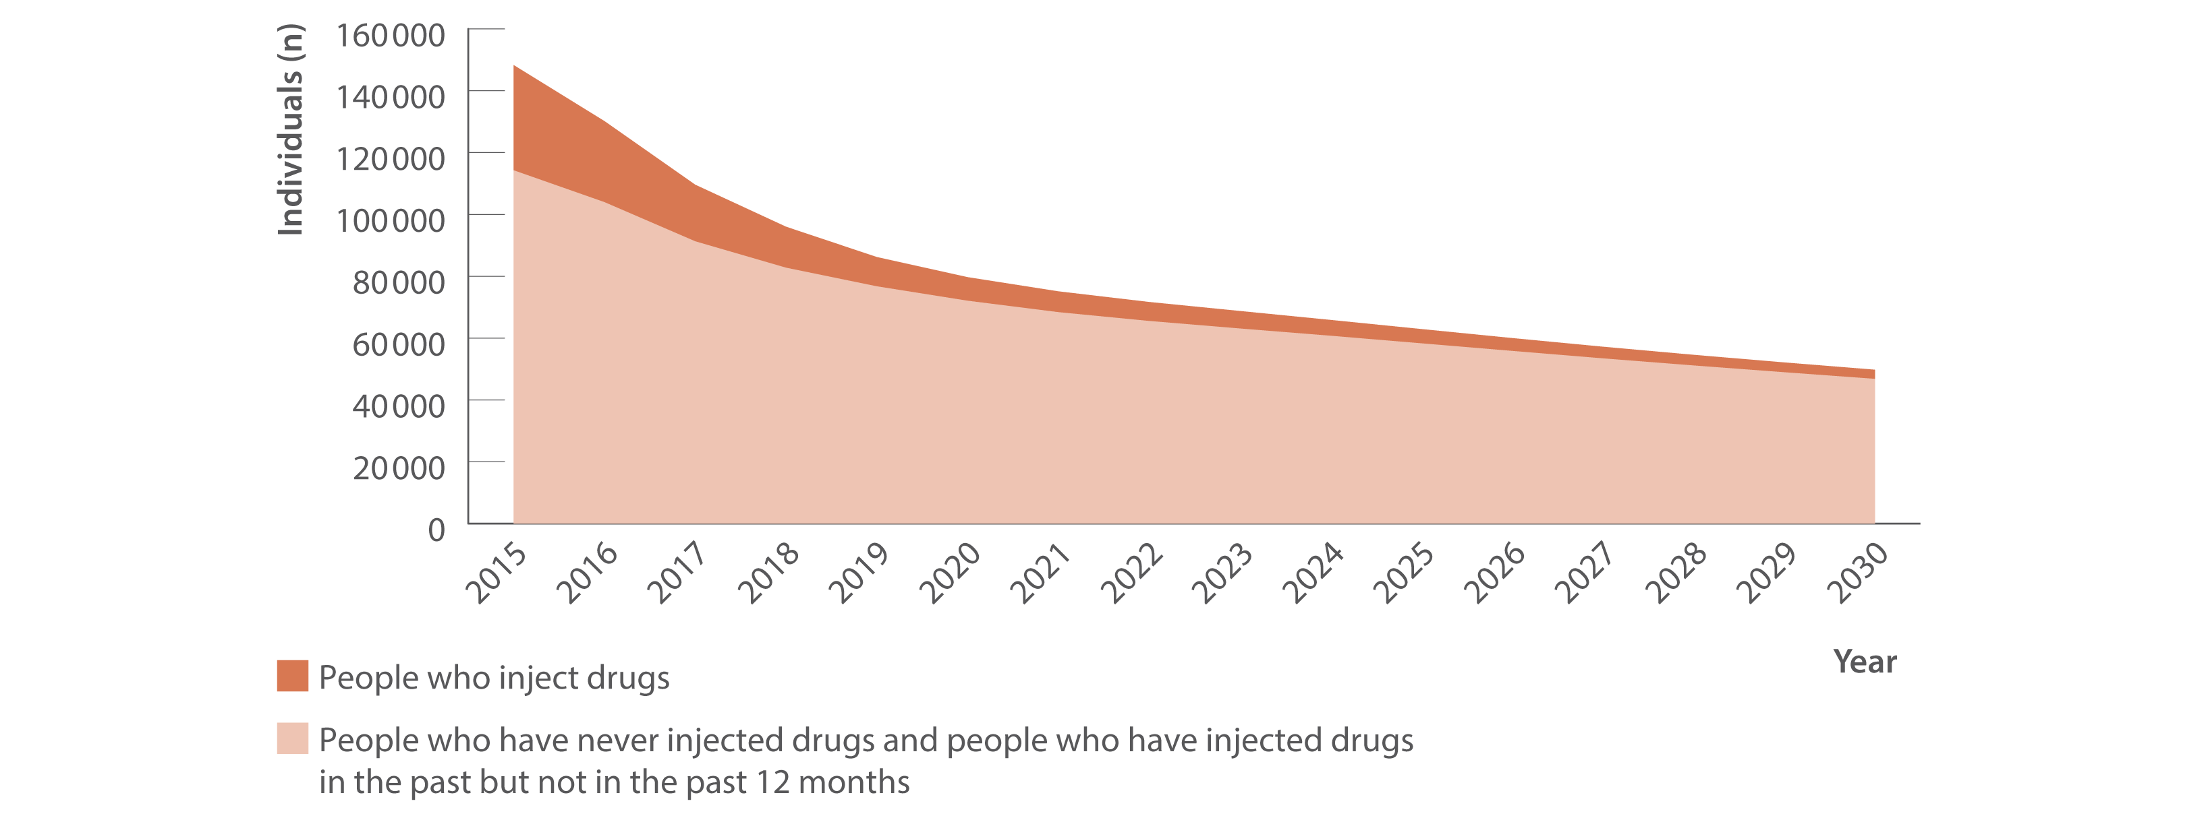
Figure 38. Estimated number of people living with chronic hepatitis C by injecting drug use status, 2015–2030
Modelling elimination
Source: Personal communication, Farah Houdroge and Nick Scott (Burnet Institute).

Slide 50
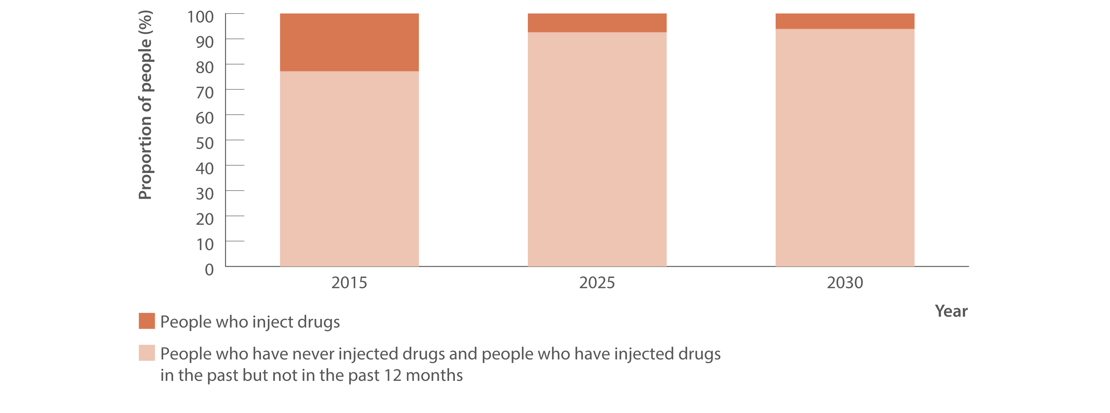
Figure 39. Estimated proportion of people living with chronic hepatitis C by injecting drug use status, 2015, 2025, and 2030
Modelling elimination
Source: Personal communication, Farah Houdroge and Nick Scott (Burnet Institute).

Slide 51
Supported by

Slide 52
Data Contributors

Slide 53
Methods
For full methods are available in the online report: burnet.edu.au/hep-c-report

Slide 54
References
1. Alavi M, Law MG, Valerio H, et al. Declining hepatitis C virus‑related liver disease burden in the direct‑acting antiviral therapy era in New South Wales, Australia. J Hepatol. 2019;71(2):281–8. doi: . https://doi.org/10.1016/j.jhep.2019.04.014
2. Dore GJ, Feld JJ. Hepatitis C virus therapeutic development: In pursuit of “perfectovir” . Clin Infect Dis. 2015;60(12):1829–36. doi: . https://doi.org/10.1093/cid/civ197
3. Doyle JS, Aspinall E, Liew D, et al. Current and emerging antiviral treatments for hepatitis C infection. Br J Clin Pharmacol. 2013;75(4):931–43. doi: https://doi.org/10.1111/j.1365‑2125.2012.04419.x
4. King J, McManus H, Kwon J, et al. HIV, viral hepatitis and sexually transmissible infections in Australia: Annual surveillance report 2024. Sydney, Australia: Kirby Institute UNSW Sydney; 2024. Available from: (accessed: 15th September 2025). https://www.kirby.unsw.edu.au/research/reports/asr2024
5. Naruka E, King J, Miller A, et al. Bloodborne viral and sexually transmissible infections in Aboriginal and Torres Strait Islander peoples: Annual surveillance report 2024. Sydney, Australia: Kirby Institute UNSW Sydney; 2024. Available from: (accessed: 20th August 2025). https://www.kirby.unsw.edu.au/research/reports/Blood‑borne‑viral‑and‑sexually‑transmissible‑infections‑in‑Aboriginal‑and‑Torres‑Strait‑Islander‑peoples‑Annual‑surveillance‑report‑2024
6. Bah R, Sheehan Y, Li X, et al. Prevalence of blood borne viruses and uptake of hepatitis C testing and treatment in Australian prisons: The AusHep Study. Lancet Reg Health West Pac. 2024;53:101240. doi: . https://doi.org/10.1016/j.lanwpc.2024.101240
7. World Health Organization. Global health sector strategies on, respectively, HIV, viral hepatitis and sexually transmitted infections for the period 2022–2030. Geneva, Switzerland: World Health Organization; 2022. Available from: https://www.who.int/publications/i/item/9789240053779 (accessed: 1st September 2025).
8. Australian Government, Department of Health, Disability and Ageing. Fifth National Hepatitis Strategy 2018–2022. Canberra, Australia: Australian Government, Department of Health, Disability and Ageing; 2019. Available from: (accessed: 5th September 2025). https://www.health.gov.au/resources/publications/fifth‑national‑hepatitis‑c‑strategy‑2018‑2022
9. Kwon JA, Dore GJ, Grebely J, et al. Australia on track to achieve WHO HCV elimination targets following rapid initial DAA treatment uptake: A modelling study. J Viral Hepat. 2019;26(1):83–92. doi: . https://doi.org/10.1111/jvh.13013
10. Kwon JA, Dore GJ, Hajarizadeh B, et al. Australia could miss the WHO hepatitis C virus elimination targets due to declining treatment uptake and ongoing burden of advanced liver disease complications. PLoS One. 2021;16(9):e0257369. doi: . https://doi.org/10.1371/journal.pone.0257369
11. Australian Government, Department of Health, Disability and Ageing. National Notifiable Disease Surveillance System. Canberra, Australia: Australian Government, Department of Health, Disability and Ageing; 2022. Available from: (accessed: 18th September 2025). https://www.health.gov.au/our‑work/nndss
12. O’Keefe D, Horyniak D, Dietze P . From initiating injecting drug use to regular injecting: Retrospective survival analysis of injecting progression within a sample of people who inject drugs regularly. Drug Alcohol Depend. 2016;158:177–80. doi: . https://doi.org/10.1016/j.drugalcdep.2015.11.022
13. Burnet Institute, Kirby Institute, NRL Quality. The Australian Collaboration for Coordinated Enhanced Sentinel Surveillance of Sexually Transmissible Infections and Blood Borne Viruses (ACCESS). Melbourne, Australia: Burnet Institute, Kirby Institute, and NRL Quality; 2025. Available from: https://accessproject.org.au/ (accessed: 22nd September 2025).
14. Callander D, Moreira C, El‑Hayek C, et al. Monitoring the control of sexually transmissible infections and blood‑borne viruses: Protocol for the Australian Collaboration for Coordinated Enhanced Sentinel Surveillance (ACCESS). JMIR Res Protoc. 2018;7(11):e11028. doi: . https://www.researchprotocols.org/2018/11/e11028

Slide 55
15. Nguyen L, Stoové M, Boyle D, et al. Privacy‑preserving record linkage of deidentified records within a public health surveillance system: Evaluation study. J Med Internet Res. 2020;22(6):e16757. doi: . https://www.jmir.org/2020/6/e16757/
16. Australasian Society for HIV, Viral Hepatitis and Sexual Health Medicine (ASHM). National Hepatitis C Testing Policy v1.4 2020. Sydney, Australia: Australasian Society for HIV, Viral Hepatitis and Sexual Health Medicine (ASHM); 2020. Available from: ‑hcv‑ testing ‑ policy/ http://testingportal.ashm.org.au/national (accessed: 26th September 2025).
17. Hepatitis C Virus Infection Consensus Statement Working Group. Australian recommendations for the management of hepatitis C virus infection: a consensus statement (2022). Melbourne, Australia: Gastroenterological Society of Australia; 2022. Available from: (accessed: 17th June 2025). https://www.hepcguidelines.org.au/
18. Heard S, Mathers B, Maher L. Australian NSP survey: Prevalence of HIV, HCV and injecting and sexual behaviour among NSP attendees, 30‑year National Data Report 1995–2024. Sydney, Australia: Kirby Institute UNSW Sydney; 2025. Available from: (accessed: 26th September 2025). https://www.kirby.unsw.edu.au/research/projects/ansps
19. Australian Government, Services Australia. Medicare Australia Statistics. Canberra, Australia: Australian Government, Services Australia. Available from: (accessed: 7th July 2025). http://medicarestatistics.humanservices.gov.au/statistics/mbs_item.jsp
20. National Prisons Hepatitis Network. Sydney, Australia: Kirby Institute UNSW Sydney; 2022. Available from: (accessed: 13th September 2025). https://www.nphn.net.au/about
21. Kirby Institute at UNSW Sydney and the Flinders University International Centre for Point‑of‑Care Testing. Australian HCV Point ‑of ‑C are Testing Program Sydney, Australia: Kirby Institute UNSW Sydney; 2024. Available from: (accessed: 8th October 2025). https://hepcpoct.com.au/
22. Carrington N, Conway A, Grebely J, et al. Testing, diagnosis, and treatment following the implementation of a program to provide dried blood spot testing for HIV and hepatitis C infections: the NSW DBS Pilot. BMC Infect Dis. 2024;24(1):137. doi: ‑024‑08989 ‑8. https://doi.org/10.1186/s12879
23. Scott N, Sacks‑Davis R, Wade AJ, et al. Australia needs to increase testing to achieve hepatitis C elimination. Med J Aust. 2020;212(8):365–70. doi: https://doi.org/10.5694/mja2.50544
24. Martin NK, Thornton A, Hickman M, et al. Can hepatitis C Virus (HCV) direct‑acting antiviral treatment as prevention reverse the HCV epidemic among men who have sex with men in the United Kingdom? Epidemiological and modeling insights. Clin Infect Dis. 2016;62(9):1072–80. doi: . https://doi.org/10.1093/cid/ciw075
25. Scott N, McBryde ES, Thompson A, et al. Treatment scale‑up to achieve global HCV incidence and mortality elimination targets: a cost‑effectiveness model. Gut. 2017;66(8):1507–15. doi: . http://dx.doi.org/10.1136/gutjnl ‑2016 ‑311504
26. Kirby Institute. Monitoring hepatitis C treatment uptake in Australia (Issue 15). Sydney, Australia: Kirby Institute UNSW Sydney; July 2025.
Available from: https://www.kirby.unsw.edu.au/research/reports/monitoring-hepatitis-c-treatment-uptake-australia-issue-15-july-2025 (accessed: 4th September 2025).
27. Yee J, Carson J, Hanson J, et al. Real world efficacy of antiviral therapy in chronic hepatitis C (REACH‑C). Sydney, Australia: Kirby Institute UNSW Sydney; 2019. Available from: https://www.kirby.unsw.edu.au/research/projects/reach-c (accessed: 4th October 2024).
28. Carson JM, Hajarizadeh B, Hanson J, et al. Retreatment for hepatitis C virus direct ‑ acting antiviral therapy virological failure in primary and tertiary settings: the REACH‑C cohort. J Viral Hepat. 2022;9 (24):661–76. doi: . https://doi.org/10.1111/jvh.13705
29. Carson JM, Barbieri S, Matthews GV, et al. National trends in retreatment of HCV due to reinfection or treatment failure in Australia. J Hepatol. 2022;78(2):260–70. doi: https://doi.org/10.1016/j.jhep.2022.09.011

Slide 56
30. Traeger MW, Pedrana AE, van Santen DK, et al. The impact of universal access to direct‑acting antiviral therapy on the hepatitis C cascade of care among individuals attending primary and community health services. PLoS One. 2020;15(6):e0235445. doi: . https://doi.org/10.1371/journal.pone.0235445
31. Burnet Institute and Kirby Institute. Australia’s progress towards hepatitis C elimination: annual report 2020. Melbourne, Australia: Burnet Institute; 2020. Available from: https://www.burnet.edu.au/our-work/
projects/eliminate-hepatitis-c-australia-ec-australia/hepatitis-c-in-australia-2024-statistics/ (accessed: 5th September 2025).
32. Burnet Institute and Kirby Institute. Australia’s progress towards hepatitis C elimination: annual report 2021. Melbourne, Australia: Burnet Institute; 2021. Available from: https://www.burnet.edu.au/our-work/
projects/eliminate-hepatitis-c-australia-ec-australia/hepatitis-c-in-australia-2024-statistics/(accessed: 5th September 2025).
33. Burnet Institute and Kirby Institute. Australia’s progress towards hepatitis C elimination: annual report 2022. Melbourne, Australia: Burnet Institute; 2022. Available from: https://www.burnet.edu.au/our-work/
projects/eliminate-hepatitis-c-australia-ec-australia/hepatitis-c-in-australia-2024-statistics/ (accessed: 5th September 2025).
34. Burnet Institute and Kirby Institute. Australia’s progress towards hepatitis C elimination: annual report 2023. Melbourne, Australia: Burnet Institute; 2023. Available from: https://www.burnet.edu.au/our-work/
projects/eliminate-hepatitis-c-australia-ec-australia/hepatitis-c-in-australia-2024-statistics/ (accessed: 5th September 2025).
35. Burnet Institute and Kirby Institute. Australia’s progress towards hepatitis C elimination: annual report 2024. Melbourne, Australia: Burnet Institute; 2024. Available from: https://www.burnet.edu.au/our-work/
projects/eliminate-hepatitis-c-australia-ec-australia/hepatitis-c-in-australia-2024-statistics/ (accessed: 5th September 2025).
36. Australia and New Zealand Liver and Intestinal Transplant Registry. Melbourne, Australia: Austin Hospital; 2025. Available from: (accessed: 5th August 2025). https://www.anzlitr.org/
37. Broady TR, Cama E, Brener L, et al. Responding to a national policy need: development of a stigma indicator for blood‑borne viruses and sexually transmissible infections. Aust N Z J Public Health. 2018;42(6):513–5. doi: ‑6405.12809 . https://doi.org/10.1111/1753
38. Broady TR, Brener L, Vuong T, et al. Online interventions to reduce stigma towards population groups affected by blood borne viruses in Australia. Int J Drug Policy. 2021;96:103292. doi: . https://doi.org/10.1016/j.drugpo.2021.103292
39. Livingston JD, Milne T, Fang ML, et al. The effectiveness of interventions for reducing stigma related to substance use disorders: a systematic review. Addiction. 2012;107(1):39–50. doi: https://doi.org/10.1111/ j.1360 ‑0443.2011.03601.x .
40. Gronholm PC, Henderson C, Deb T, et al. Interventions to reduce discrimination and stigma: the state of the art. Soc Psychiatry Psychiatr Epidemiol. 2017;52(3):249–58. doi: ‑017‑1341 ‑9. https://doi.org/10.1007/s00127
41. Broady T, Brener L, Cama E, et al. Stigma snapshot: General public 2024. Sydney, Australia: Centre for Social Research in Health UNSW Sydney; 2024. Available from: (accessed: 15th September 2025). https://doi.org/10.26190/unsworks/30441
42. Broady T, Brener L, Cama E, et al. Stigma snapshot: Health care workers 2024. Sydney: Centre for Social Research in Health UNSW Sydney. Available from: (accessed: 8th July 2025). https://doi.org/10.26190/unsworks/30442
43. Heard S, Mathers B, Kwon J, et al. Needle Syringe Program National Minimum Data Collection: National Data Report 2024. Sydney, Australia: Kirby Institute UNSW Sydney; 2024. Available from: https://www.kirby.
unsw.edu.au/research/reports/needle-syringe-program-national-minimum-data-collection-2024-nationaldata-report (accessed: 11th August 2025).
44. Merone L, Ashton S, Harris A, et al. A complex increase in hepatitis C virus in a correctional facility: bumps in the road. Aust N Z J Public Health. 2022;46(3):377–81. doi: ‑ https://doi.org/10.1111/17536405.13238.

Slide 57
45. Hajarizadeh B, Grebely J, Byrne M, et al. Evaluation of hepatitis C treatment‑as‑prevention within Australian prisons (SToP‑C): a prospective cohort study. Lancet Gastroenterol Hepatol. 2021;6 (7):533–46. doi: ‑1253(21)00077 ‑7. https://doi.org/10.1016/S2468
46. Cunningham EB, Hajarizadeh B, Bretana NA, et al. Ongoing incident hepatitis C virus infection among people with a history of injecting drug use in an Australian prison setting, 2005–2014: the HITS‑p study. J Viral Hepat. 2017;24(9):733–41. doi: https://doi.org/10.1111/jvh.12701
47. Sutherland R, Uporova J, Karlsson A, et al. Australian Drug Trends 2024: key findings from the National
Illicit Drug Reporting System (IDRS) Interviews. Sydney, Australia: National Drug and Alcohol Research Centre UNSW Sydney; 2024. Available from: (accessed: 8th October 2025). https://www.unsw.edu.au/research/ndarc/resources/australian‑drug‑trends‑2024‑key‑findings‑from‑the‑idrs
48. Broady T, Rance J, Brener L, et al. Annual Report of Trends in Behaviour 2025: Viral Hepatitis, HIV, STIs and Sexual Health in Australia. Sydney, Australia: Centre for Social Research in Health UNSW Sydney; 2025. Available from: (accessed: 3rd October 2025). https://www.unsw.edu.au/research/csrh/our‑projects/annual‑report‑of‑trends‑in‑behaviour
49. Holt M, Lea T, Mao L, et al. Adapting behavioural surveillance to antiretroviral‑based HIV prevention: reviewing and anticipating trends in the Australian Gay Community Periodic Surveys. Sex Health. 2017;14(1):72–9. doi: . https://doi.org/10.1071/SH16072
50. MacLachlan J, Purcell I, Mondel A, et al. Viral Hepatitis Mapping Project: National Report, Hepatitis C 2023–2024. Sydney, Australia: Australasian Society for HIV, Viral Hepatitis and Sexual Health Medicine (ASHM), 2024. Available from: (accessed: 17th August 2025). https://ashm.org.au/programs/Viral‑Hepatitis‑Mapping‑Project/
51. Australian Bureau of Statistics. National, state and territory population 2024. Canberra, Australia: Australian Bureau of Statistics. Available from: (accessed: 15th September 2025). https://www.abs.gov.au/statistics/people/population
52. Australian Bureau of Statistics. Prisoners in Australia. Canberra, Australia: Australian Bureau of Statistics; 2024. Available from: https://www.abs.gov.au/statistics/people/crime‑and‑justice/prisoners‑australia/2024 (accessed: 1st September 2025).
53. Kirby Institute. HIV, viral hepatitis and sexually transmissible infections in Australia: Annual surveillance report 2021. Sydney, Australia: Kirby Institute UNSW Sydney; 2021. Available from: (accessed: 18th October 2025). https://www.kirby.unsw.edu.au/report‑type/annual‑surveillance‑reports?page=0
54. King J, McManus H, Kwon A, et al. HIV, viral hepatitis and sexually transmissible infections in Australia: Annual surveillance report 2022. Sydney, Australia: Kirby Institute UNSW Sydney; 2022. Available from: (accessed: 8th October 2025). https://www.kirby.unsw.edu.au/report‑type/annual‑surveillance‑reports?page=0
55. King J, McManus H, Kwon J, et al. HIV, viral hepatitis and sexually transmissible infections in Australia: Annual surveillance report 2023. Sydney, Australia: Kirby Institute UNSW Sydney; 2023. Available from: (accessed: 15th February 2024). https://www.kirby.unsw.edu.au/research/reports/asr2023
56. Butler T, Simpson M. National Prison Entrants’ Blood‑borne Virus Survey Report 2004, 2007, 2010, 2013, and 2016. Sydney, Australia: Kirby Institute UNSW Sydney; 2017. Available from: (accessed: 7th October 2025). https://www.kirby.unsw.edu.au/research/reports/national‑prison‑entrants‑bloodborne‑virus‑and‑risk‑behaviour‑survey‑report‑2004‑2007‑2010‑2013‑and‑2016
57. Iversen J, Wand H, McManus H, et al. Incidence of primary hepatitis C virus infection among people who inject drugs in Australia pre‑ and post‑unrestricted availability of direct acting antiviral therapies. Addiction. 2023;118(5):901–11. doi: . https://doi.org/10.1111/add.16113

Slide 58
58. Australian Government, Department of Health, Disability and Ageing. Australian national notifiable diseases and case definitions. Canberra, Australia: Australian Government, Department of Health, Disability and Ageing; 2025. Available from: (accessed: 3rd July 2025). https://www.health.gov.au/resources/collections/cdna‑surveillance‑case‑definitions?utm_source=health.gov.au&utm_medium=callout‑auto‑custom&utm_campaign=digital_transformation
59. Australian Bureau of Statistics. Standard for Sex, Gender, Variations of Sex Characteristics and Sexual Orientation Variables. Canberra, Australia: Australian Bureau of Statistics; 2021. Available from: . https://www.abs.gov.au/statistics/standards/standard‑sex‑gender‑variations‑sex‑characteristics‑and‑sexual‑orientation‑variables (accessed: 21st November 2025).
60. Ampt FH, El‑Hayek C, Agius PA, et al. Anorectal swabs as a marker of male‑to‑male sexual exposure in STI surveillance systems. Epidemiol Infect. 2017;145(12):2530–5. doi: . https://doi.org/10.1017/S095026881700098X
61. Heard S, Maher L. Australian Needle Syringe Program Survey National Data Report 2019–2023: Prevalence of HIV, HCV and injecting and sexual behaviour among NSP attendees. Sydney, Australia: Kirby Institute UNSW Sydney; 2024. Available from: (accessed: 1st September 2024). https://www.kirby.unsw.edu.au/research/projects/ansps
62. Prince DS, Pipicella JL, Fraser M, et al. Screening Emergency Admissions at Risk of Chronic Hepatitis C (SEARCH) to diagnose or ‘re‑diagnose’ infections is effective in Australia. J Viral Hepat. 2021;28(1):121–8. doi: . https://doi.org/10.1111/jvh.13393
63. Valerio H, Alavi M, Conway A, et al. Declining prevalence of current HCV infection and increased treatment uptake among people who inject drugs: the ETHOS Engage study. Int J Drug Policy. 2022;105:103706. doi: . https://doi.org/10.1016/j.drugpo.2022.103706
64. Kirby Institute. Hepatitis C elimination in NSW: Monitoring and evaluation report, 2024. Sydney, Australia: Kirby Institute UNSW Sydney; 2024. Available from: https://www.kirby.unsw.edu.au/research/reports/hepatitis‑c‑elimination‑nsw‑monitoring‑and‑evaluation‑report‑2024#:~:text=This%20report%20evaluates%20progress%20towards (accessed: 4th October 2024).
65. Read P , Tang BZH, Silins E, et al. Hepatitis C reinfection and risk factors among clients of a low‑threshold primary healthcare service for people who inject drugs in Sydney, Australia. Viruses. 2024;16(6). doi: . https://doi.org/10.3390/v16060957
66. Scott N, Doyle JS, Wilson DP , et al. Reaching hepatitis C virus elimination targets requires health system interventions to enhance the care cascade. Int J Drug Policy. 2017;47:107–16. doi: . https://doi.org/10.1016/j.drugpo.2017.07.006

